Slide 1
How to make your writing more effective
Avoiding speed bumps on the information highway
Notes:
Good day. My name is Tom Mallory and I am the city’s staff writer.
I’ve been doing this a ling time, as an editor and a wordsmith, I love helping people with their writing and coaching staff in this area is part of my job.
I’m very excited at the opportunity to talk to you today about how we can make the city’s writing more effective.

Slide 2
Our own expertise
The biggest impediment to clear writing?

Slide 3
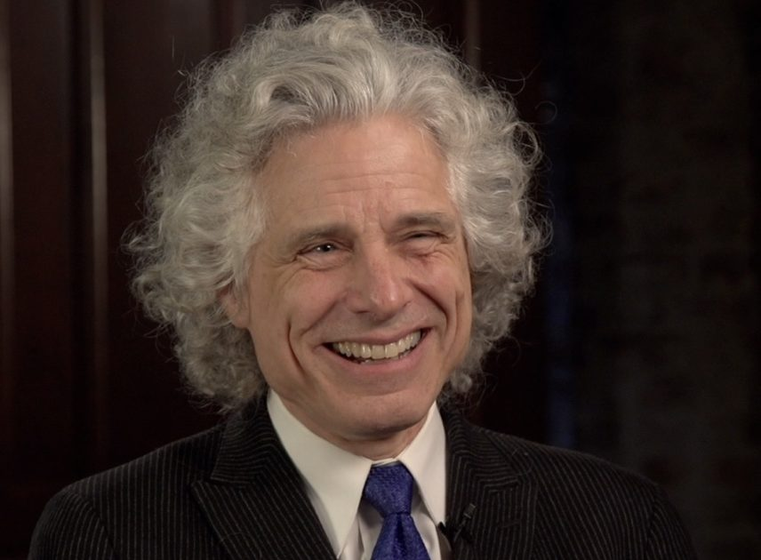
“When you know something, it’s extraordinarily difficult to know what it’s like not to know it. Your own knowledge seems so obvious that you’re apt to think that everyone else knows it, too.”
The “curse of knowledge”
Steven Pinker –
Cognitive psychologist, linguist, author of writing manual “The Sense of Style”

Slide 4
Why clear, accessible writing matters
The public needs plain language to read, understand and use government communications
People are busy, they don’t want to work to comprehend
Reduces the chance you’ll be misunderstood
Conveys a message of quality, of a well-run government
Making complex subjects clear builds trust

Slide 5
Do this before and after the writing
Always keep in mind
What will the reader need? What will the reader want?
When will they need it, where does it most logically fit?
What information do they NOT need? What can you spare them?
Will every reader understand every word and concept?
What do you want them to come away with?

Slide 6
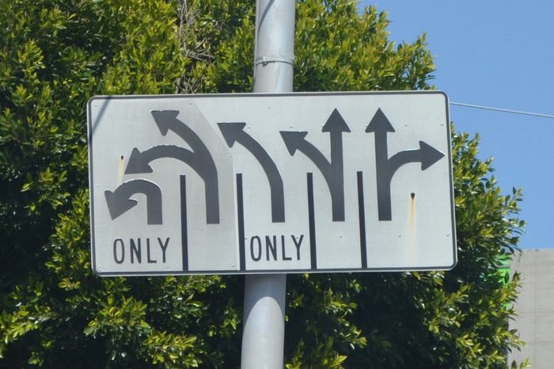
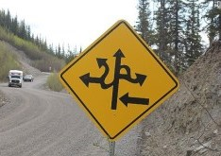
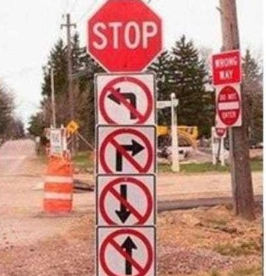
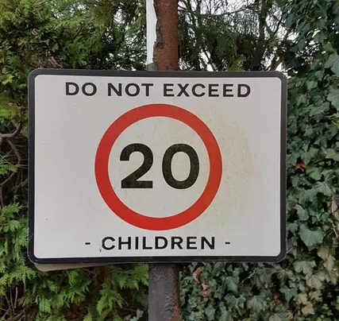
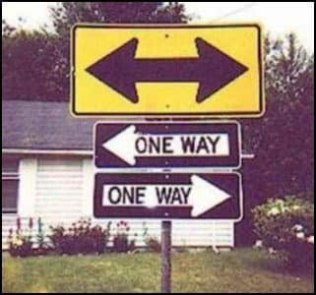
Unclear communications
Confusing
More confusing
Don’t go anywhere
Breeding limit
You are about to die

Slide 7
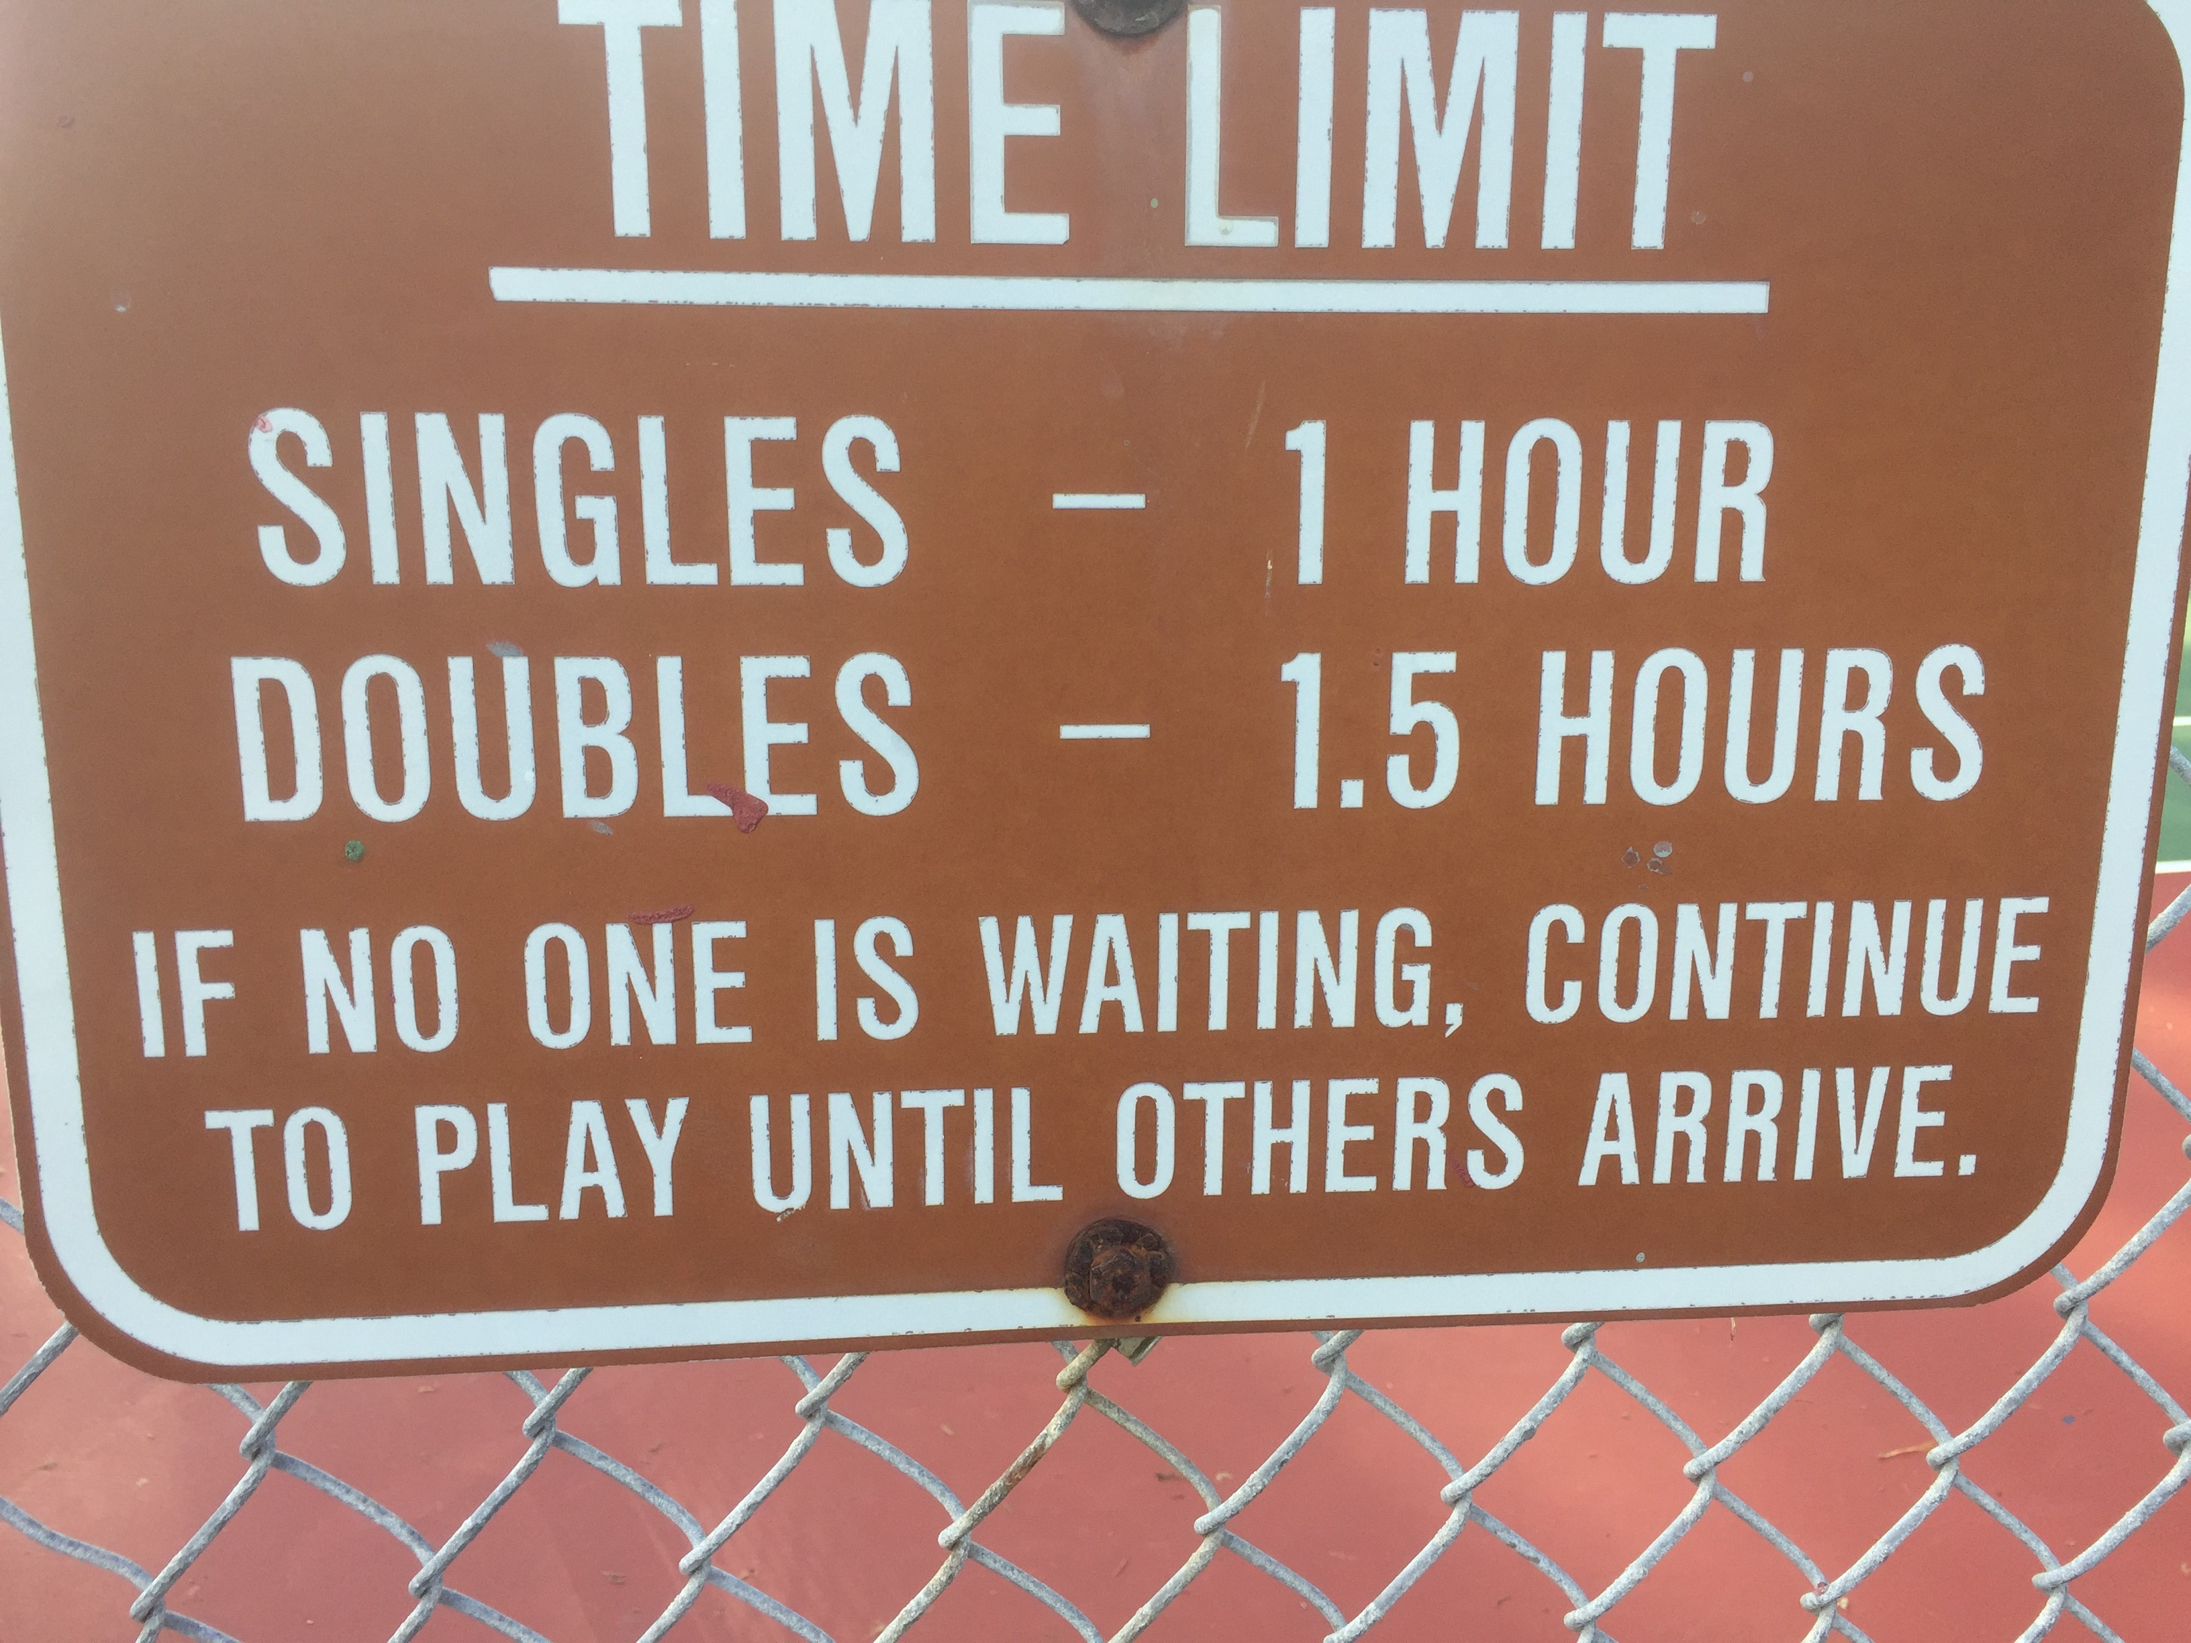
Not what they meant
Warning: You may have to play forever.

Slide 8
Making things crystal clear

Slide 9
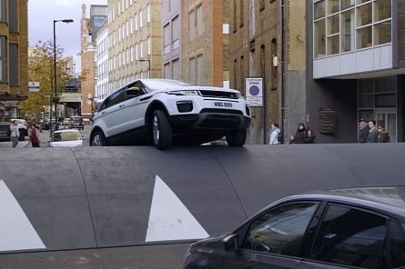
What is this speed bump thing?

Slide 10
Speed bump = anything that slows down or hinders comprehension

Slide 11
HardiePlate
Professional jargon and terms
Responsible charge
Excess dwelling unit bank
5150
Standards of coverage
GHG
Index of dissimilarity
CTLBID
Incidental take

Slide 12
Clunky punctuation
/
;
( )

Slide 13
Non-conversational phrasing
“The store was gone to yesterday by me following a telephonic conversation with my spouse pertaining to our immediate household food and beverage needs and an examination of our refrigerator and cupboard.”
“Oh. What grocery items were purchased specifically during this visit?”
“Eggs, milk and cat food were the groceries that were purchased by me at the store, which was Ralphs.”

Slide 14
The rules of the road

Slide 15
Use active tense
Active
I visited the store.
The City Council approved the plan.
A few well-chosen words convey a great deal of meaning.
Staff recommend this action to the council.
Passive
The store was visited by me.
The plan was approved.
A great deal of meaning is conveyed by a few well-chosen words.
This action is recommended to the council.
Notes:
Using the active voice conveys a strong, clear tone and the passive voice is subtler and weaker. Here’s some good advice: don’t use the passive voice just because you think it sounds a bit fancier than the active voice.
That said, there are times the passive voice is useful and called for. Take “The squirrel was chased by the dog,” for example. That sentence construction would be helpful if the squirrel were the focus of your writing and not the dog.
A good rule of thumb is to try to put the majority of your sentences in the active voice, unless you truly can’t write your sentence in any other way.

Slide 16
Beware of jargon
Avoid unnecessary jargon, in keeping with the city’s writing guidelines.
Define and explain official terms that might not be clear to a layperson, such as the Mobility Element, a density bonus, and Proposition H.
Write for the public, for the members of the City Council, not your colleagues.
More on acronyms later (MOAL)

Slide 17
Use commonly used words
Try to avoid phrases you would not use in conversation.
Pertaining to = relating, concerning
Pursuant = in keeping
Per = in accordance with
Addressing issues = fixing problems
Approximately = about
Prior to = before
Following = after

Slide 18
Capitalization
Proper nouns – “The U.S. Constitution”
But not when plural - “state constitutions”
Proper names – “The Mobility Element of the General Plan”
But only when specific - “Cities are required to have a mobility element in their general plans.”
Official job titles before a name – “Deputy Director Mary Jones”
But not without a name – “the deputy director”
Composition titles, days and months, abbreviations, etc.

Slide 19
Things that are not capitalized
Non-specific documents such as:
Request for proposals
Non-exclusive license agreement
Memorandum of understanding
Environmental impact report
Negative declaration
Job titles not appearing before a name
Processes, tools, methodologies

Slide 20
Exceptions
City is generally lowercase but we put it in uppercase when writing the City of Carlsbad
Job titles do go in uppercase on business card and document headings
We capitalize city department names on city documents for clarity and consistency, Community Development, Parks & Recreation, Finance, Human Resources, etc.

Slide 21
Plurals are squirrely
The City Council voted, but city councils vote
Resolution No. 1234 but resolutions nos. 1234, 1235 and 1236
Stagecoach Community Park but Stagecoach, Calavera Hills and Poinsettia community parks
Staff is a plural word, if only because there are a lot of us
Very common error: Subject tense disagreement.
A sentence will start off singular and then turn plural, or vice versa.
Notes:
Also it is "The City Council" not just "City Council," as in, "This was presented to the City Council in a report ... "

Slide 22
Things are its
When we refer to a body of people as a group it is a singular thing
The City Council voted on its action plan.
United Construction said it would finish the work in June.
SANDAG reported it would complete the plan in October.
If you want to add real people:
Housing and Community Development staff said they …

Slide 23
Acronyms Can Hinder Comprehension (ACHU)
With some exceptions, acronyms and their introduction in parenthesis are major speed bumps. Some guidelines:
Avoid acronyms that are not commonly known. Examples of acceptable acronyms on second reference include IRS, SANDAG, CMC, CMWD and CAP. Acronyms that will hinder comprehension: MCLGS, RTFH, LFMZ, CalOES, CBTID and most others.
Don't introduce acronyms in parenthesis, instead just say or, as in, “The Climate Action Plan, or CAP, …"

Slide 24
ACHU 2
AP STYLEBOOK
A few universally recognized abbreviations are required in some circumstances. Some others are acceptable, depending on the context. But in general, avoid alphabet soup. Do not use abbreviations or acronyms that the reader would not quickly recognize.
CITY STYLE GUIDE
Reading a city document should not require a government reference guide. Unless you are sure your audiences knows your jargon, avoid it or explain it as you go. Remember, your main goal is to be understood. (No, it doesn’t help to put the acronym after the term in parentheses.)

Slide 25
Slash the slash
A slash does not mean “and.”
Use a slash, rather than a hyphen, for constructions such as and/or, either/or, over/under.
Don’t use a slash in between two words that mean the same thing if you must introduce both terms.

Slide 26
Semicolons are hard
Not that hard
Use to separate items in a list that also must be set off by commas: “The City Council approved the contracts with Amalgamated Industries, of Anaheim; Best Builders, of Barstow; and Consolidated Contractors, of Colton.”
Hard (at least for me)
Use to separate two related but distinct thoughts: “The package was due last week; it arrived today. “
Tip: Just use ”and,” ”but” or ”for.” Or make it two sentences.

Slide 27
Parenthetically speaking
A parenthesis acts almost like a period, a full stop, and a lot of time we use it to insert a fact in a shorthand way.
It’s usually a smoother read to either use commas or write it out.
The company committed 40% ($327,300) to the project.
The company committed 40%, or $327,300, to the project.
AP stylebook
“… Be sparing with them. Parentheses are jarring to the reader. …The temptation to use parentheses is a clue that a sentence is becoming contorted. Try to write it another way.”

Slide 28
Dates and times
When month is used with a specific date, abbreviate these months this way:
Jan., Feb., Aug., Sept., Oct., Nov. and Dec.
When a phrase lists only a month and a year, don’t separate the year with commas. When a phrase refers to a month, day and year, set off the year with commas.

Slide 29
Dates and times examples
The city updated the plan in January 2016.
The hearing was Jan. 2.
The council voted May 8.
Feb. 14, 2013, was the target date.
The board approved the plan Friday, Dec. 3.
The meeting will be held from 10 a.m.-noon, Tuesday, July 13, 2021.
The building will be open from 9 a.m.-5 p.m., Monday through Friday.

Slide 30
Let lists be lists
A long list in a sentence format can be hard to follow and to compare the items. A bulleted or numbered list is easier on the reader.
A numbered or bulleted list does not need semicolons, commas or periods after each item unless they are complete sentences that require periods, like these.
With a few exceptions, lists don’t need “and”s and “or”s either.
Staff recommends the council:
Approve the resolution approving the change in city policy
Consider the implementation options listed below
Direct staff on how to implement the change

Slide 31
The dreaded Oxford comma*
This is the comma that goes before “and” in a list, as in, “My favorite foods are pizza, spaghetti, and steak.”
Usually not needed, acts like a little speed bump
Needed when last two items in the list could be confused as one
* He’s clearly biased.
Notes:
The disagreement stemmed from the fact there’s no Oxford, or serial, comma in the “packing for shipment or distribution” part.
IN this case, drivers for a dairy argued that due to a lack of a comma between “packing for shipment” and “or distribution”, the law refers to the single activity of “packing”, not to “packing” and “distribution” as two separate activities. As the drivers distribute – but do not pack – the goods, this would make them eligible for overtime pay.

Slide 32
When Oxford comma is needed
Maine’s overtime law that says it doesn’t apply to “canning, processing, preserving, freezing, drying, marketing, storing, packing for shipment(,) or distribution of” foods.
One thing or two things?
Notes:
The disagreement stemmed from the fact there’s no Oxford, or serial, comma in the “packing for shipment or distribution” part.
IN this case, drivers for a dairy argued that due to a lack of a comma between “packing for shipment” and “or distribution”, the law refers to the single activity of “packing”, not to “packing” and “distribution” as two separate activities. As the drivers distribute – but do not pack – the goods, this would make them eligible for overtime pay.

Slide 33
Delete unneeded words
Words and phrases such as “furthermore,” “in addition” and “in conclusion” are often not needed. The organization of the text can usually convey that message effectively.
If you are writing in the present tense, it is “currently.” Save this word for when you want to imply a change is coming.
Avoid using “however” or “but” as a transition when there is no juxtaposition of concepts.

Slide 34
“Because” and “said” are perfectly fine words
Because is clearer than “as” or “since.” It has only one meaning, so requires less thought to process.
What’s “due to” for? So we can avoid writing “because” twice in a sentence.
Words like “said” or “told” are invisible, they convey the meaning instantly.
Words like “reported,” “communicated,” “informed” and “conveyed” aren’t wrong, but they can sound stilted and carry other connotations.

Slide 35
That is that, and which is which
If you can drop the clause and not lose the meaning of the sentence, use which. Otherwise, use that.
Does the sentence make sense without that clause? Use “which”
Does the sentence break without that clause? Use “that”

Slide 36
We use sentence case in titles
City is moving away from capitalizing all the words in a document or webpage title
Having Every Word Capitalized Makes for a Bumpy Road

Slide 37
A note ON Typography
Excessive formatting, unusual fonts, and colors that do not convey information can be major speedbumps and may even cause temporary blindness.
Ok not really. But they don’t look professional.
City style:
Calibri (Body) at 12 pt.
Hierarchy of type for headers and subheads:
Boldfaced
Underlined
Italicized

Slide 38
The five tips you came for
Think it out before you type it out.
What are the necessary elements?
What will the reader need?
Would photos, charts or graphics help tell the story?
What is the most logical organization?
What can you leave out?
Notes:
Straight road, as few twists and turns as possible.

Slide 39
The five tips you came for
Put your important facts and concepts at the beginning or the end of paragraphs and sections.
Example: We often put the date first, but it’s usually the least important thing.
People remember the first and last note of the concert.
Use that prime placement for the points you want to emphasize.
Notes:
Straight road, as few twists and turns as possible.

Slide 40
The five tips you came for
Look at every word. Every. Single. Word.
Is it needed?
Example: She worked at five different companies.
Is it just the right word?
Example: Demonstrates Consistent with the prudent management of the city’s financial resources.
Is there a shorter word that would get the job done quicker?
Example: If mitigation just means repairs, repairs is the better word.
Notes:
Straight road, as few twists and turns as possible.

Slide 41
The five tips you came for
Step back and look at the concepts with a fresh eye. (This is hard.)
Are they in the most logical order?
Does every part lead naturally to the next?
Is something out of place?
Remember, you want to give your readers a nice straight road, with as few twists and turns – and offramps – as possible.
Notes:
Straight road, as few twists and turns as possible.

Slide 42
The five tips you came for
Now step back and look at the formatting and the structure.
Sentences and paragraphs should not be structured identically. A variety of lengths and structures is easier to read, and helps keep the reader going.
Use short declarative sentences to emphasize your key points.
Occasional one-sentence paragraphs are OK.
Would a passage work better as a bulleted or numbered list?
Again, are the sentences and paragraphs in the most logical order?
Notes:
Straight road, as few twists and turns as possible.

Slide 43
One extra credit tip
Read it out loud.
You will likely identify rough spots you repeatedly read right over on the screen.
Notes:
Straight road, as few twists and turns as possible.

Slide 44
Spot the style error(s)
These laws are interpreted in regulations, Fair Political Practices Commission Decisions, Attorney General Opinions and publications, and in judicial decisions.
These laws are interpreted in regulations, Fair Political Practices Commission decisions, attorney general opinions and publications, and in judicial decisions.

Slide 45
Spot the errors, make it better
Amalgamated Construction said they expect to be done with the project in 48 months, commencing in Jan. 2020.
Amalgamated Construction said it expects to commence the project in January 2020 and complete it in four years.

Slide 46
Which is right?
Which date is written in the approved city writing style?
Jan. 8, 2014
January 8th, 2014
January 8, 2014
A. Jan. 8, 2014

Slide 47
How to make this clearer?
The City Manager verbally communicated to city council that, as the cost of the item would exceed one million dollars, Proposition H would apply.
The city manager told the City Council that because the item would cost more than $1 million, a vote of the people would be required for its approval under the terms of Proposition H.

Slide 48
How to make this easier to read?
On December 9 2020, a measure was approved by City Council, on a 4-1 vote, (Resolution No. 1234) that authorized the expenditure of the funding necessary to positively impact the completion term of the subject project.
The City Council approved the funding for the work needed to expedite the project Dec. 9, 2020, (Resolution No. 1234, approved 4-1).

Slide 49
Questions? Comments?

