Slide 1
Village, Barrio & Beach Area Parking Study
Pam Drew and Brett Wood
August 22, 2017

Slide 2
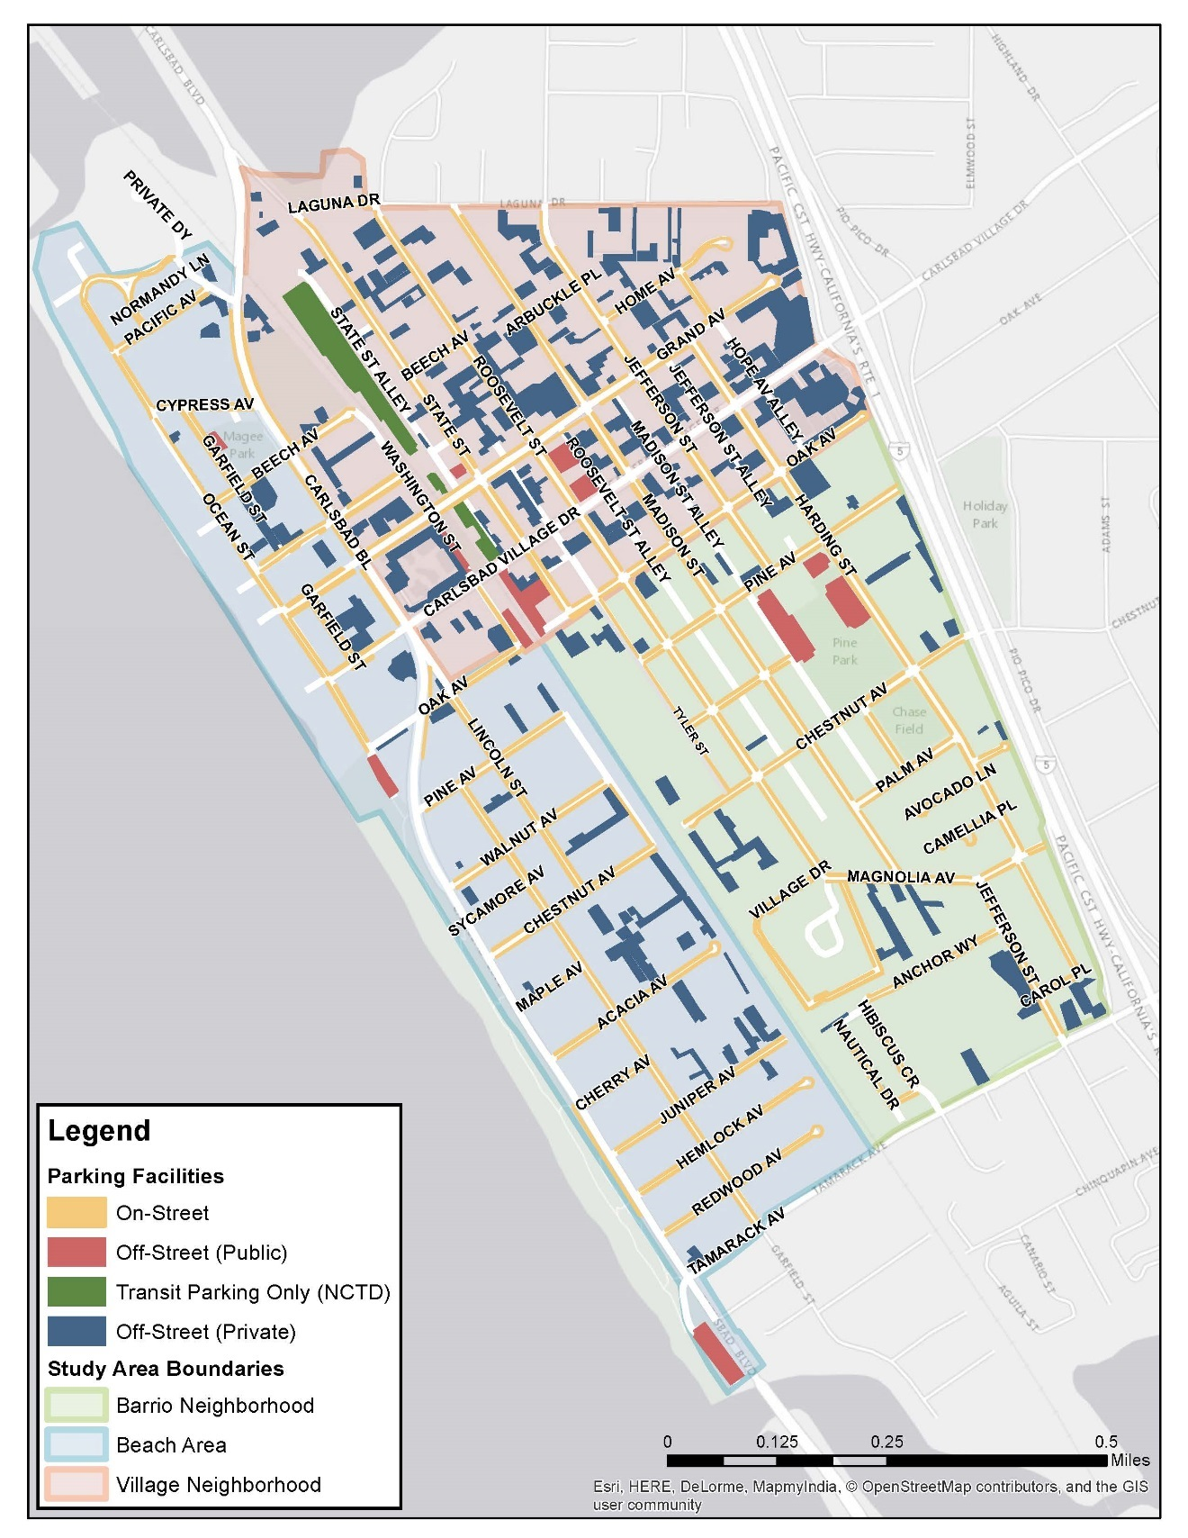
Parking Study Goals
Make parking more convenient
Efficient use of existing supply
Support future parking needs
Explore alternative transportation options
Support the Village and Barrio Master Plan vision
Notes:
Need to clearly explain the purpose of collecting inventory of both the public and private parking spaces. Private parking spaces remain private property. This map just presents all of the parking in the study area that was analyzed

Slide 3
Study Process (to date)
Public Outreach, Data Collection & Analysis
(May 2016 - November 2016)
Technical Memorandum #1
Park+ Analysis
(November 2016 - March 2017)
Technical Memorandum #2
Program & Peer Review
(November 2016 - April 2017)
Technical Memorandum #3
DRAFT Parking Management Plan
(April 2017 - present)

Slide 4
Public Outreach
4,420 postcard mailings
12 Neighborhood & Community meetings
825 online survey responses
2,139 on-site survey responses
90 attendees at Public Workshop
Facebook ad reaching 10,997 people
Twitter post reaching 8,000 people
E-newsletter to 662 people
Notes:
The survey was available in English and Spanish, and for on-site surveys, we had surveyors who were bilingual as well.
Intercept survey results
50% drive alone
54% park on-street
58% less than 2 minutes to park
62% parked 2 blocks or less from destination

Slide 5
Public Comment Themes
Safety of pedestrians and cyclists
Meeting the needs of persons with disabilities
Parking in-lieu fee amount
Shuttle or trolley service
Plan adaptability
Parking garage
Paid parking concerns
Notes:
Paid parking
Public comments supported both sides of the issue.
want to keep parking free (no paid parking) - majority of comments say they like coming here to park b/c the parking is free
A minority supported meters – one argument was that the money would pay for clean-up of streets

Slide 6
Public Comment Themes
Oversized vehicles
Residential permits
Too many cars in area
No parking problem
Enhanced enforcement
Viability of shared parking
Notes:
Paid parking
Public comments supported both sides of the issue.
want to keep parking free (no paid parking) - majority of comments say they like coming here to park b/c the parking is free
A minority supported meters – one argument was that the money would pay for clean-up of streets

Slide 7
Future Parking Conditions - Results
Parking Occupancy by Scenario (July, weekend 7 p.m.)
Scenario | Average Peak Occupancy | # of Vehicles Parking in Study Area
Existing | 54% | 6,295
1. Buildout (2035) | 61 % | 7,103
2. Shared Parking (2035) | 62 % | 7,212
3. New 500-Space Parking Garage (2035) | 58 % | 7,093
Notes:
Existing peak times and days
Village: July, weekday, 1pm
Barrio: May, weekend, 9am
Beach: July, weekend, 7pm
Buildout data from 4 sources:
The estimated new commercial and hotel development (to buildout) from the General Plan Environmental Impact Report.
The distribution of commercial development in the Village and Barrio based on potential “opportunity” sites identified for the city’s Envision Carlsbad process in 2012 and updated by staff.
The distribution of hotel development based on proposed, approved, or under construction projects and potential hotel locations identified by staff.
The estimated residential dwelling unit buildout projections prepared as part of the city’s Housing Element, updated in 2017.
Development assumptions
137,400 sq ft of commercial development
1,280 residential units
260 hotel rooms
SANDAG projected growth factor of 1.4%
¼ mile walking tolerance
Scenario 1
Assumes complete future buildout and maintaining current parking management approaches
Worst case scenario
Scenario 2
Assumes maximum future buildout with shared parking facilities and maintaining current parking management approaches
Also incorporates use of shared parking
private facilities in the Village and northern beach area that had occupancies of 0-50 percent were changed in the model so that the parking was unrestricted, allowing the public to park in those underutilized facilities
Scenario 3
Includes buildout from scenarios 1 & 2
Included and evaluated the addition of a 500-space facility in the Village and the beach area north of Oak Ave
General Comments
Overall system approx. 60% occupied in all scenarios-underutilized
The beach area and on-street parking throughout the Village exceed effective capacity
Scenario 1
Greatest project increase in demand
Scenario 2
The reclassified underutilized facilities were projected to be able to meet their current demands as well as accommodate demands from surrounding businesses
Scenario 2 shows greater balancing of the system where the existing parking spaces are used more efficiently, resulting in an increase in occupancy. More vehicles are able to park in the study area because the private parking is now available to the public
Scenario 3
- Parking demands were widespread throughout the study area and not concentrated to a single location. This makes constructing new parking difficult because a single facility, or even two facilities, would struggle to absorb the unmet demands throughout the entire study area.

Slide 8
Parking Management Strategies
Reconfiguration and curb lane management
Parking time limits
Enforcement and ambassadors
Shared and leased parking
In-lieu fees
Reduced parking requirements
Parking wayfinding
Notes:
Immediate strategies included herein, longer term strategies can be discussed after the meeting if desired.
Each strategy presented should be adapted to the appropriate needs of the neighborhood(s) and the City. (Stress flexibility and parking manager leading these efforts for expert knowledge and consistency and communicating between departments)
It should be clear in the presentation that while the study indicates that the City doesn’t need to invest in a public parking structure, the study does not preclude the possibility of a privately-owned parking structure in the area

Slide 9
Parking Program Structure
Hire Parking Manager
Drive and oversee the program
Program communication and marketing
Ongoing data collection
Implement Plan Strategies
Decisions based on data
Flexible and adaptable implementation

Slide 10
Reconfiguration and Curb Lane Management
Review red curbs and driveway closures
Consider angled parking and safety tradeoffs
Develop specific curb lane management program
Accommodation for all users
Consideration for ADA parking spaces
Notes:
ADA - Responsibility falls on the city and they’ll look at it through the CLM
Actively installing on-street ADA spaces
ADA is part of sustainability plan
Restriping to add 40 parking spaces to Beech (diagnol to parallel) and Carlsbad blvd
All short-term recommendations
Mid and long term – continue
Carlsbad Blvd and Beech St as examples of restriping
Angled parking
Emphasize bike safety
Where its possible
Current Bike Study for Village and Barrio Master Plan (underway)is looking into these strategies

Slide 11
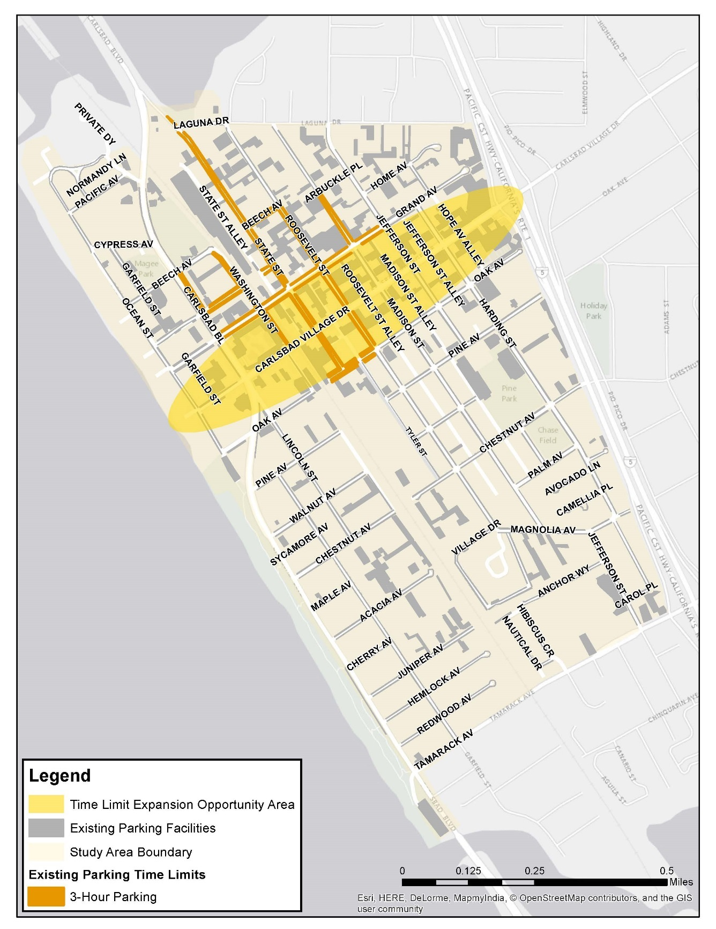
Parking Time Limits
Enforce existing time limits
Reduce time restriction for oversize vehicles to 24 hrs
Revise oversized vehicles ordinance
Revise overnight parking restrictions in residential areas
Notes:
Maintain and enforce existing time limits
data collected and analyzed as part of this study indicate that the two- and three-hour time limit restrictions are currently adequate
most people in the Village (where time limit regulations are currently posted) parked for two hours or less
indicates the need for proactive enforcement to encourage employees to park off-street
annual collection of parking occupancy and duration data can be used to adjust time limit regulations to meet the changing needs of the community
may be suitable to implement shorter time limits to influence turnover or longer time limits to influence a shift in demand
Extend time limits hours and to new areas
New areas
commercial development is planned to intensify in the Village
Grand Avenue through the length of the study area (from Ocean Street to I-5)
on streets between Grand Avenue and Oak Avenue
Although the Master Plan calls for future growth in these areas, real growth may occur differently than what is anticipated
city should evaluate parking occupancies and duration annually
review of commercial developments to identify areas of commercial growth
Extend time limits after 5pm to 4 hours
Areas are still active after 5pm with dining and other nightlife
Restaurant land uses generally require longer parking use than retail
4 hours better accommodates the after 5pm crowd visiting restaurants and other nightlife destinations
Maintaining restrictions after 5pm reflect the observed peak demand of 7pm in the study area
Revise parking restrictions
Overnight
Current overnight parking restrictions prevent non-residential users from parking on the street
This negatively impacts residents, especially north end of State Street
City should review necessity and other potential management solutions
Oversized vehicles
During public outreach, many comments concerning RVs parking on-street for extended periods
Recommended reduction from 72 hours to 24 hours
Limits long-term RV parking and camping on city streets to better maintain public access to the beach for recreational purposes
Provide restrictions on website
Interactive map of parking facilities
# of spaces available
Time limits and restrictions

Slide 12
Enforcement and Ambassadors
Proactive, sporadic enforcement patterns
Extend enforcement hours to 8 p.m.
Graduated fine structure
Enforcement officers act as ambassadors
Evaluate enforcement resources and strategies
Notes:
Evaluate enforcement resources and strategies
self-operation
Management contract
Concession agreement
First offense warnings
Use of advanced technology in future (mobile mounted LPR)

Slide 13
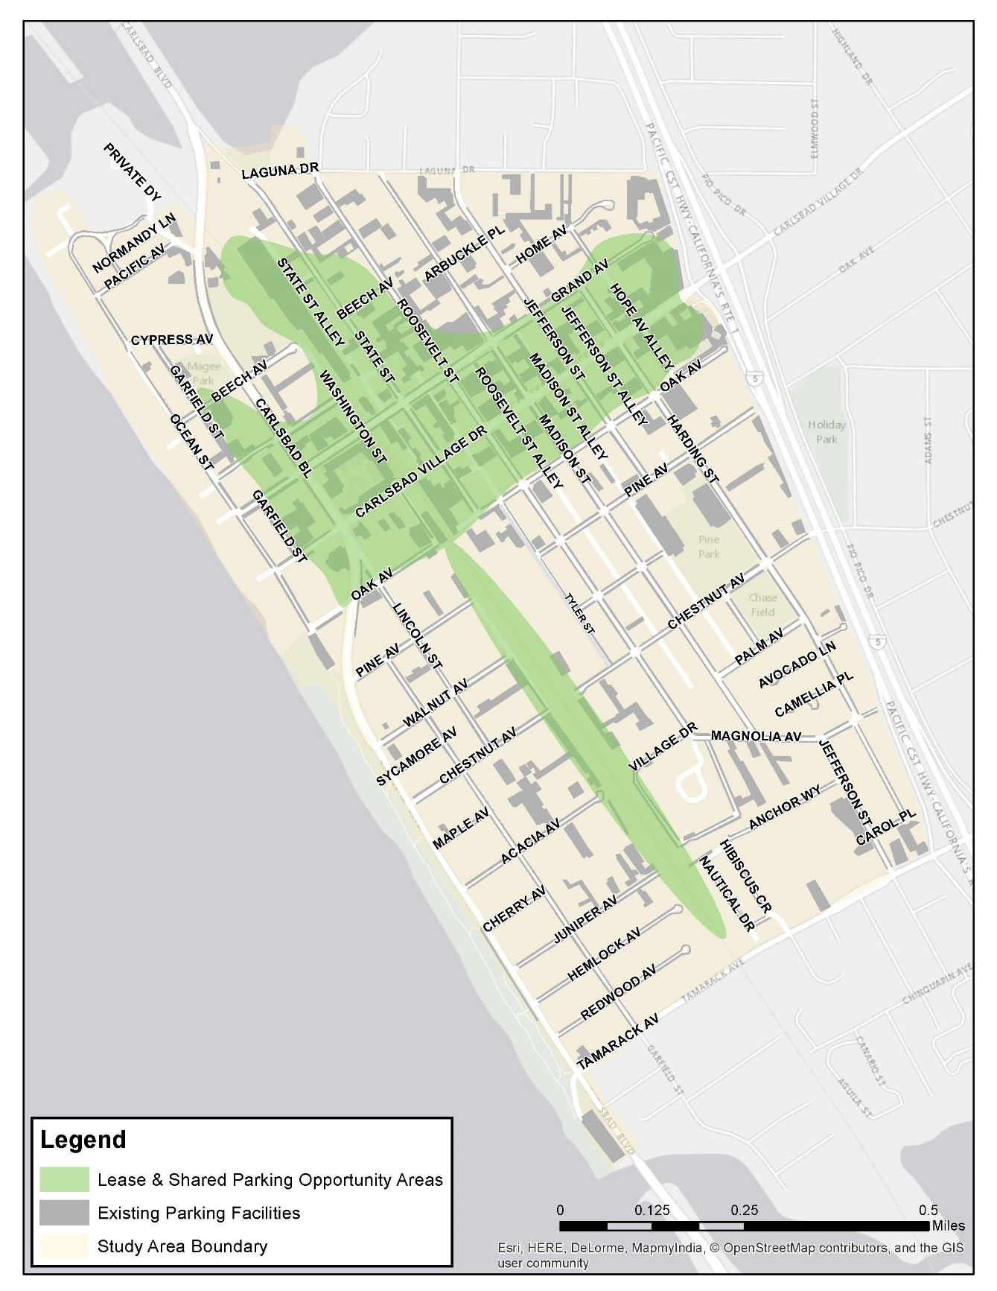
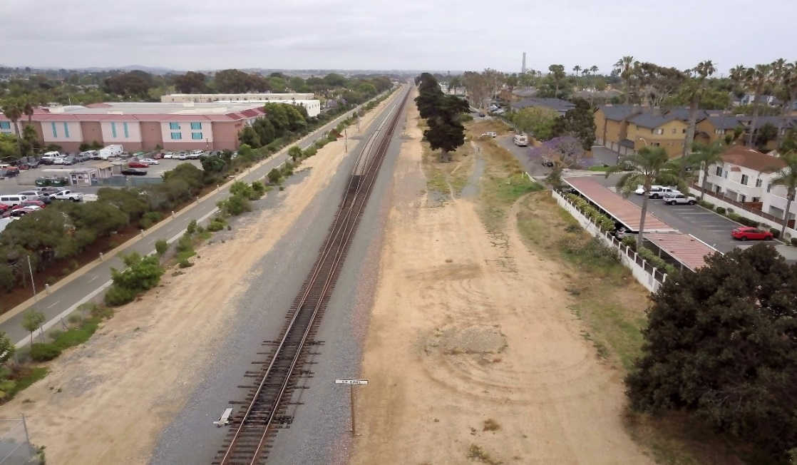
Shared and Leased Parking
Optional participation
Flexibility over time
Actively broker lease agreements
Liability insurance
Revise distance requirement in Village
Notes:
Stress that this is currently an option and needs promotion – parking manager with experience
Not mandatory, but rather an option that businesses can use
Businesses can opt to inventory their parking supply for the city in an attempt to maximize the use of their parking facility or identified surrounding opportunities to relieve their parking demands
Needs promotion so that businesses can understand the pros and cons to participating (area has a large supply, understanding of where their needs can be met, more economical as they don’t have to construct new parking if they don’t want to, etc.)
The shared lots will evolve over time as the area grows and changes. The agreements can be modified or eliminated over time.
City will provide information, education and guidance to businesses in the study area
Lease agreements templates and resources
Understanding of parking supply, study area occupancies, and what opportunities mean for businesses (don’t have to build on-site parking which means its more economical to locate in the study area)
City is currently leasing spaces from NCTD and has plans to continue to do so and expand their agreement to new areas (along RR tracks)
Maintain and broker shared parking agreements to encourage development
Identify parking that is underutilized and is within 1,320 feet of the destination/business
Park+ modeling utilized facilities at or below 50% occupied
Can be adapted as opportunities are reviewed
Revise existing distance requirements for shared parking from 150 feet and 300 feet
Update to ¼ mile (1,320 feet)
5 minute walk
Information to back-up the 5-minute walk: Reasonable Walking Distance – An urban planning principle that recognizes if streets are safe, comfortable, and interesting, most people will walk a distance of about a quarter mile (about two to three blocks in the Village) or approximately five minutes before turning back or opting to drive or ride a bike instead. Backup for this, as noted in TM#2, is from “Draft Village and Barrio Master Plan,” April 2016; and the “New Urbanism: Best Practices Guide,” New Urban News Publications, 2009.
Use incentives to encourage businesses and developers to participate
Reduced parking minimums requirements
Maintenance services (line striping or lot cleaning)
Provision of liability insurance
Consider the pedestrian experience
Utilize shared parking opportunities to create off-site employee parking
works best when on-street parking is regulated with time limits or paid parking
employees must choose citation, inconvenience of moving vehicle, permitted off-site location
Utilize shared parking opportunities for valet parking
Lease parking for public use
Existing private facilities
NCTD facilities
Monitor shared parking system annually

Slide 14
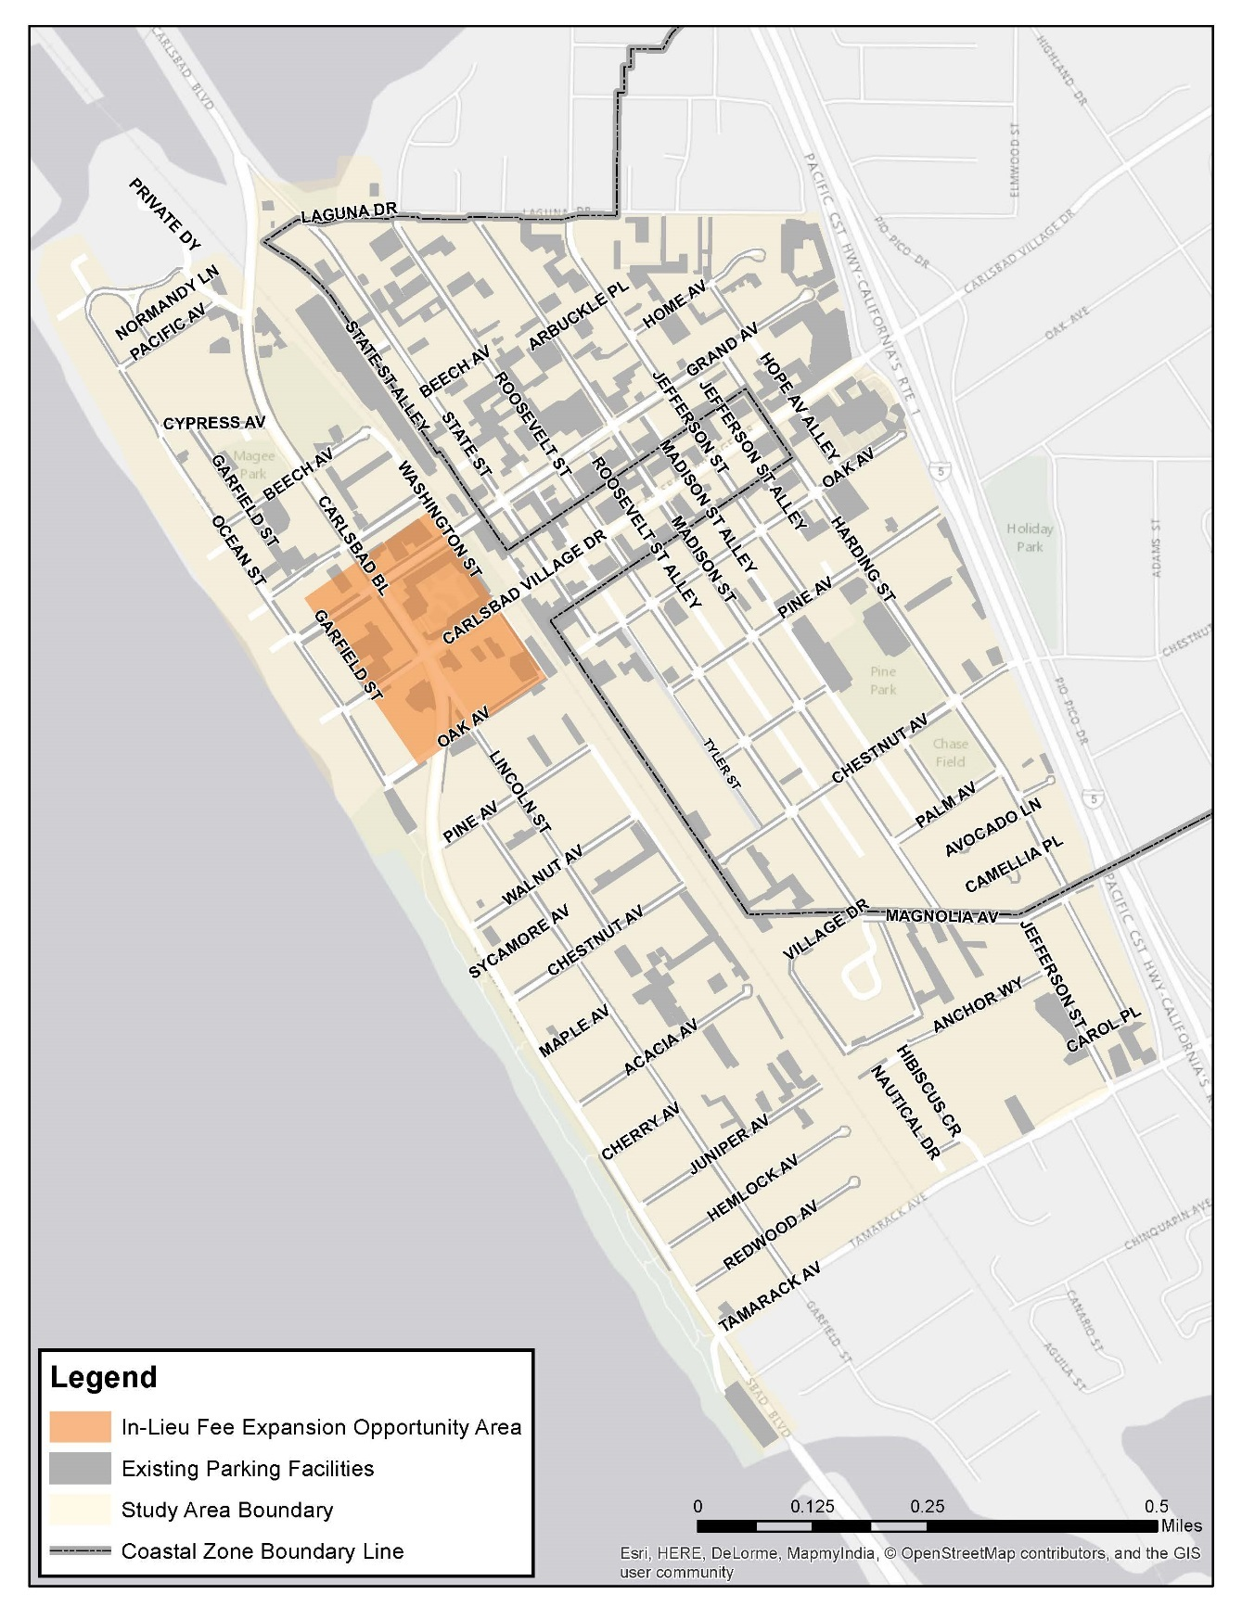
In-Lieu Fees
Use regulations to encourage participation
Fund shared and leased parking
Maintain the current rate
Notes:
chosen not to increase due to low participation in the program. A lower fee will incentivize participation.
Commissioners concerned with they aren’t’ collecting money – they’ve collected money – money should continue to support surface parking and lease/shared parking

Slide 15
Reduced Parking Requirements
Adopt rates in the Draft Village and Barrio Master Plan
Monitor implementation and demand
Notes:
Implement requirements in the Draft Village and Barrio Master Plan
Strategies are founded in peer cities reviewed as part of this study
Adopted rates don’t include accepting the guest parking rate, but the others for businesses and residents
there is insufficient data to provide parking recommendations for the Barrio. The parking study collected occupancy & turnover data but did not collect information on who was parking in the Barrio (employees, residents, etc.). Further data collection would be required to make a data-driven recommendation.

Slide 16
Parking Wayfinding
Smartphone applications
Interactive parking map on website
Additional themed signage

Slide 17
Supporting Strategies – Transportation Demand Management
Develop and adopt TDM ordinance
TDM outreach and encouragement
Expand wayfinding signage
Circulator transit service
Improve bike and pedestrian networks
Expand bike parking
Passenger loading locations/valet services
Notes:
Recommendations
Ongoing interdepartmental coordination
Ongoing program evaluation
Provide employer based TDM programs
Improved bicycle and pedestrian networks
Transit-focused infrastructure upgrades
Note the unknowns associated with autonomous vehicles and how it could impact the area over time

Slide 18
Next Steps
Take input from public, Planning Commission, and City Council until August 31
Incorporate comments as needed
Return Final Parking Management Plan to Council September 2017 for acceptance
Incorporate Final Parking Management Plan recommendations into the Draft Village and Barrio Master Plan

Slide 19
Questions?
Notes:
General Talk Points:
Emphasize the importance of data collection and hiring a parking manager to continuously evaluate parking conditions within the study area
Strategies are flexible and they are tools that are necessary to adjust as they evaluate each year
It should be clear in the presentation that while the study indicates that the City doesn’t need to invest in a public parking structure, the study does not preclude the possibility of a privately-owned parking structure in the area
Didn’t look at areas outside of our scoped study area
Analyzed and evaluated each sub-area of the study area individually (village, barrio, and beach)

