Slide 1
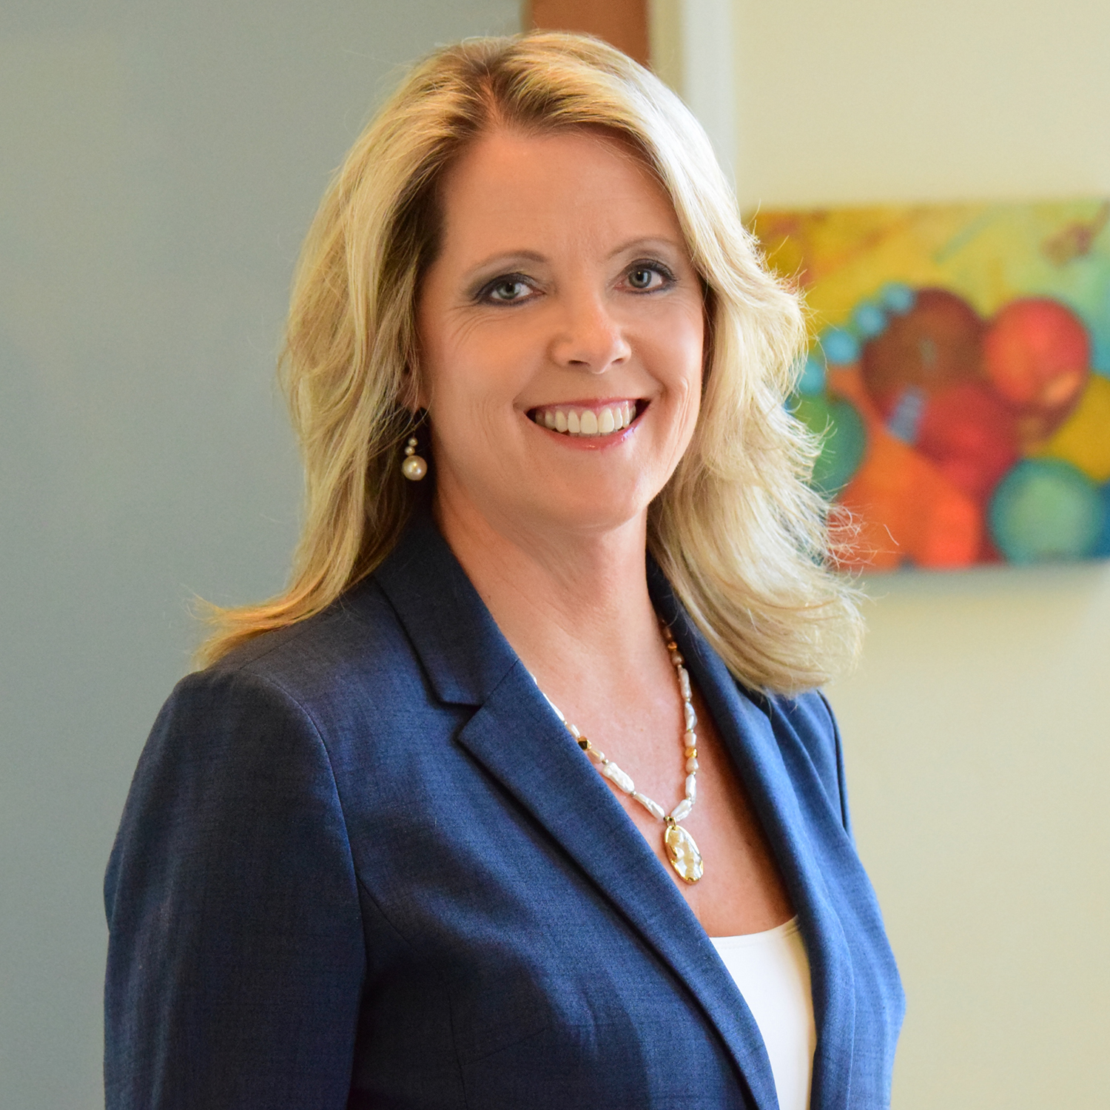
Sara Gilman, PsyD, LMFT
Coherence Associates, Inc., Co-Founder, CEO
Past-President, EMDR International Association
EMDRIA Certified Approved Consultant
Fellow, American Academy of Experts in Traumatic Stress
Sports Psychology Certification
Former Fire Fighter / EMT

Slide 2
Your home office & parenting
Pandemic Stress – Why is it unique & challenging?
Making the transition to ‘home’ office.
Tricks from others’ household trenches.
What is working…what is not...solutions for now.
Keys to survive & thrive personally & in business during COVID-19
No experts/Audio mute until group discussion/recorded –employees only/ASK QUESTIONS & SHARE

Slide 3
Pandemic Stress Why is it unique & challenging?
Shared Globally & locally
Unfamiliar enemy – learning how to fight it in REAL- TIME
Uncertainty - timing & impact & recovery
Cumulative chronic stress breaks down resilience

Slide 4
Let’s be real! We are all in this together…
The age of the kids matters
Little ones, school age, teens, college…

Slide 5
“I’m not working from home, I’m at home during a crisis trying to work”
Work ’friends’ – naturally together every day – now not
Does my boss think I’m being productive? Am I? Change in measuring stick of productivity.
What if I end up losing my job?
What if I am wondering if I even like my job anymore, is the normal?

Slide 6
Home schooling…is it summer break yet?
Most parents don’t have any training & didn’t want to be a teacher anyway! Keep your expectations LOW!
Age & personality of child determines steps to take.

Slide 7
Making the transition to ‘home’ office.
Change in routine in time & space – disorienting & forgetful
You’re home so you must be available…new game plan & rules
Frustrations around not having what you need- where you need it
How to re-orient yourself from worker to parent in a split second – no commute to difuse or refresh
Both parents are ’working’ –who’s is more important?

Slide 8
Tricks from others’ household trenches Sara & Tom – Both started new jobs in the last 6 weeks National Director Brand Partnerships & Regional Sales Manager-Midwest 2 year old & 5 year old boys
FLEXIBLE structure to your day
OUTSIED every day & develop NON_SCREEN time activities inside
leverage the art of pairing – doing laundry + audio book OR school time = parent yoga
fights OK - disrespect NOT OK
Give yourself a ‘time-out’ it’s not selfish it’s self-survival!
Get up, Get dressed, Drink WATER & OVER communicate with spouse about daily needs
Divide & conquer – chores, cooking, schooling, bed time routines & work hours
Self-compassion & patience when it comes to technology, home schooling & work duties
Virtual Childcare – Grandparents reading to them or Friend Group Talks

Slide 9
What is working…what is not...solutions for now, are you dealing with grief?
Age of kids MATTERS!
Don’t compare to others!
What works one day???Flex yourself!
Ask other family members for ideas!
Conflicts – COUNT ON IT!

Slide 10
Keys to survive & thrive personally & in business during COVID-19
Make NO major life decisions during COVID-19!
Consider ALL possibilities of life changes that may enrich your life as you move through this.
SELF-CARE * SELF-CARE * SELF-CARE What you do now MATTERS later!
Create specific routines of stress management & stress relief for you & your family! Aromas! Breathing exercises! Flowers!
Stay connected & Disconnect when needed.

Slide 11
What is Psychological Resilience & how to sustain it & strengthen it during times of uncertainty
Bounce – Mind & Body Strength & Wellbeing
Managing increasing anxiety due to uncertainty:
Anxiety is contagious = panic (toilet paper, rice, beans)
Resilience Keys
Sleep, Fuel, Connections, Regulating Emotions & Mindset
How to Build Daily Resilience:
Tactical Tips: R&R!!! Routines & Regulation
HRV & Bi-Tapp

Slide 12
Start where you are… identify how you got there & where you want to go
Pandemic
Check… moment to moment!
*Where are you this week?
Notes:
DAILY SELF ASSESSMENT – GIVE YOURSELF SOME GRACE

Slide 13
Coping with “chronic” Fatigue, Fear & Panic: 3 Selves
Fear = Can’t think straight, unmotivated, irritates relationships
1. Overwhelmed Self – defenseless, vulnerable, childlike, scared.
2. Adult Self – capable, soothes & reassures.
3. Survival Self – reactive impulsive, bouncing off walls, counter-productive.
Tony Schwartz & Emily Pines, Harvard Business Journal Series – March 2020

Slide 14
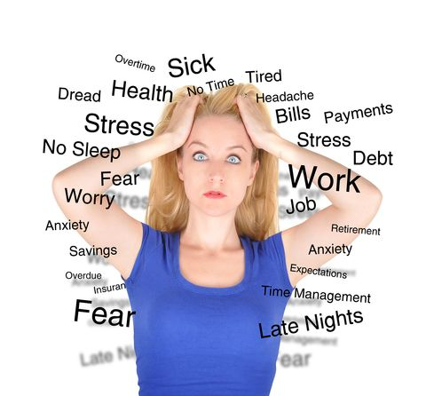
Heart Rate Variability Training = Zone/ Flow
Zone = absence of thought, cognition, & emotion
Heart Rate Coherence = Heart & Brain synced up, creating a flow of communication & energy
Promotes healthy SLEEP!!! (REM!)
HeartMath.com
Notes:
6 WEEKS BEFORE OLYMPICS…FALLING, CAN’T SLEEP – EVERYONE FELT LIKE FAILURE
8 YRS. SPORTS PSYCHOLOGIST – DID IT ALL...NOTHING WORKS
LOOKED EXHAUSTED – TOOK HX OF PROBLEM
TAUGHT HRV – GAVE EM WAVE
SLEEP FOR 1ST TIME – NEXT DAY MARKED DIFFERENCE
NOW IDENTIFY TARGETS & GO!
INTENSIVES EACH WEEK FOR 5 WEEKS

Slide 15
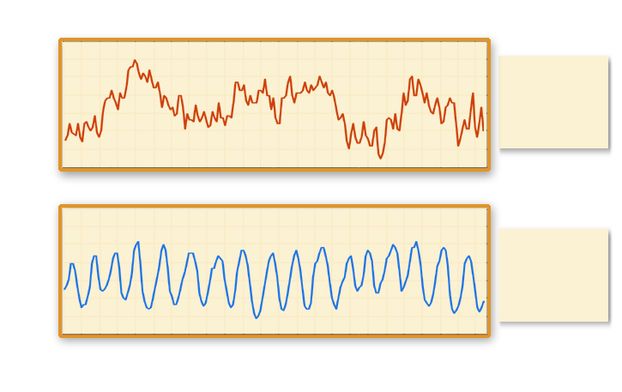
Heart Rhythms
100 –
90 –
80 –
70 –
60 –
50 –
Incoherence: Impairs Performance—Amplifies Energy Drains
Inhibits Brain Function
Incoherence
HEART RATE
100 –
90 –
80 –
70 –
60 –
50 –
Coherence: Promotes Optimal Performance—Builds Resilience
Facilitates Brain Function
Coherence
HEART RATE
1 50 100 150 200
TIME (SECONDS)
HeartMath.com

Slide 16
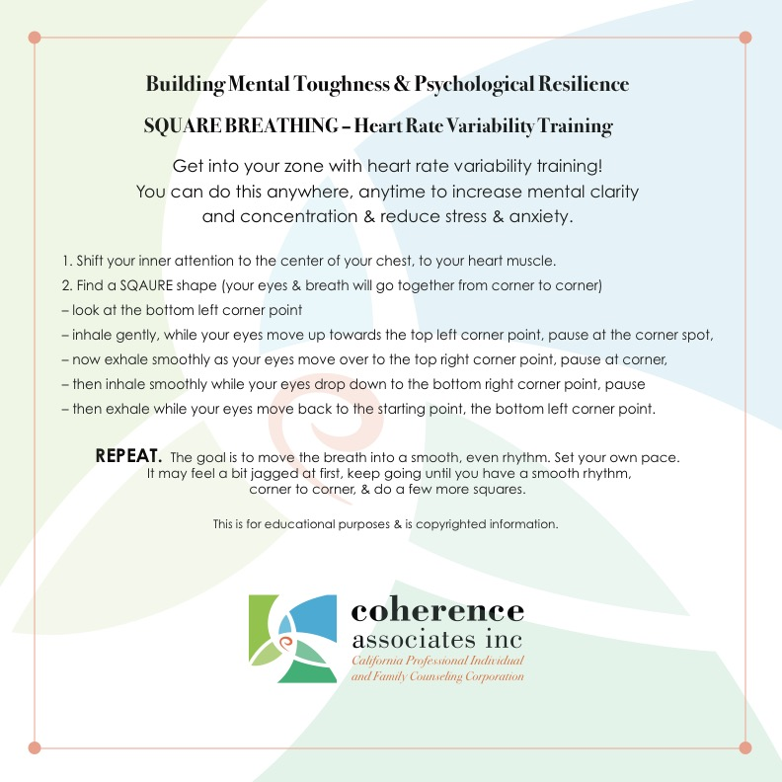
Rapid emotional & cognitive shifting…
Do this together as a family.
Do it alone ANYTIME to reset.
Notes:
DEMO

Slide 17
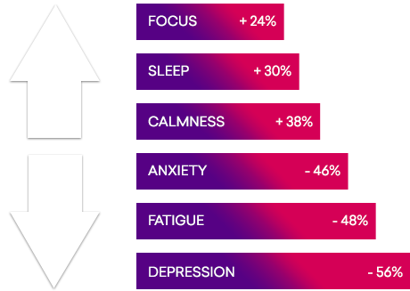
Studies conducted with over 11,500* people have shown improvements in mental & emotional well-being in just 6-9 weeks using HeartMath training and technology:
24% improvement in ability to focus 30% improvement in sleep 38% improvement in calmness 46% drop in anxiety 48% drop in fatigue 56% drop in depression
HEARTMATH.COM

Slide 18
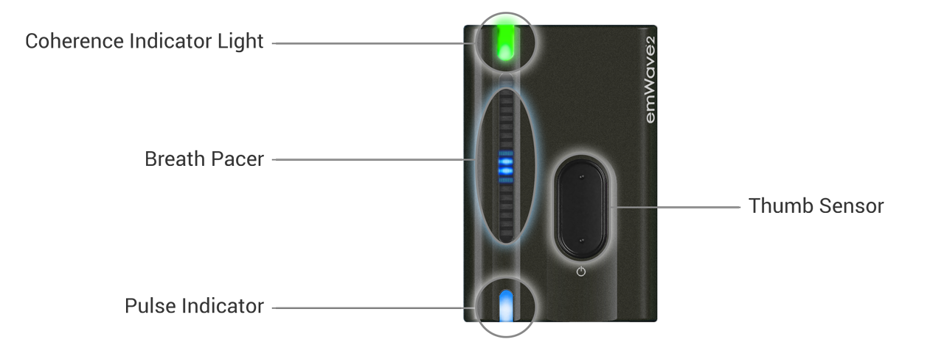
Heartmath.org
InnerBalance
EmWave 2
Notes:
SELF HELP DEVICES BY THE ONE OF THE TOP STRESS MANAGEMENT COMPANIES IN THE WORLD.
EVIDENCE-BASED INTERVENTIONS
HAVE IT AT THE OFFICE, CARRY IT WITH YOU.

Slide 19
Optimal response window
Fight
Flight
Freeze
PEAK PERFORMANCE
OPTIMAL RESPONSE
EASY CONCENTRATION
SUSTAINABLE
FLOW OF IDEAS
IMPROVED LISTENING
IMPROVED COMMUNICATION
ENERGY EFFICIENT

Slide 20
“Tap” into a greater state of focus & calm
Easy Steps
Place your hands in front of your face, palms toward face.
Cross your hands, until you can link your thumbs.
Bring your linked hands, towards the center of your chest, where your fingers can touch just below your clavicle bones.
Now, gently tap your fingers on your upper chest, left & right, back & forth.
Keep going at your own pace, as long as you want, breathe.
When you feel a sense of relaxing or calming you can stop.
If you feel more agitated, irritable, keep going.
Alternative tapping positions:
Cross your arms & hug your upper arms, gently tap or squeeze your arms left & right.
Sitting down – tap your upper thighs with your hands, left & right, breathe!
Dr Gilman- Butterfly Hug- YouTube: https://youtu.be/RQxKedYGyU8

Slide 21
Increases
Devices that help!
Sense of Calm
Emotional Resilience – Flex
Mindfulness Skills
Focus & Attention
Productive Sleep
DECREASES
Reactions to triggers
Emotional Dysregulation
Test Anxiety
Stress & Anxiety
Chronic Pain
*Lower regions of the brain sense tapping – AUTO-PAY
*BS activates hemispheres = inhibits amygdala hijack!
-Robert Scaer, MD(2012) 8 Keys to Brain-Body Balance, p144
Bi-Tapp.com - DRSARA
Notes:
EASY PASSIVE INTERVENTION

Slide 22
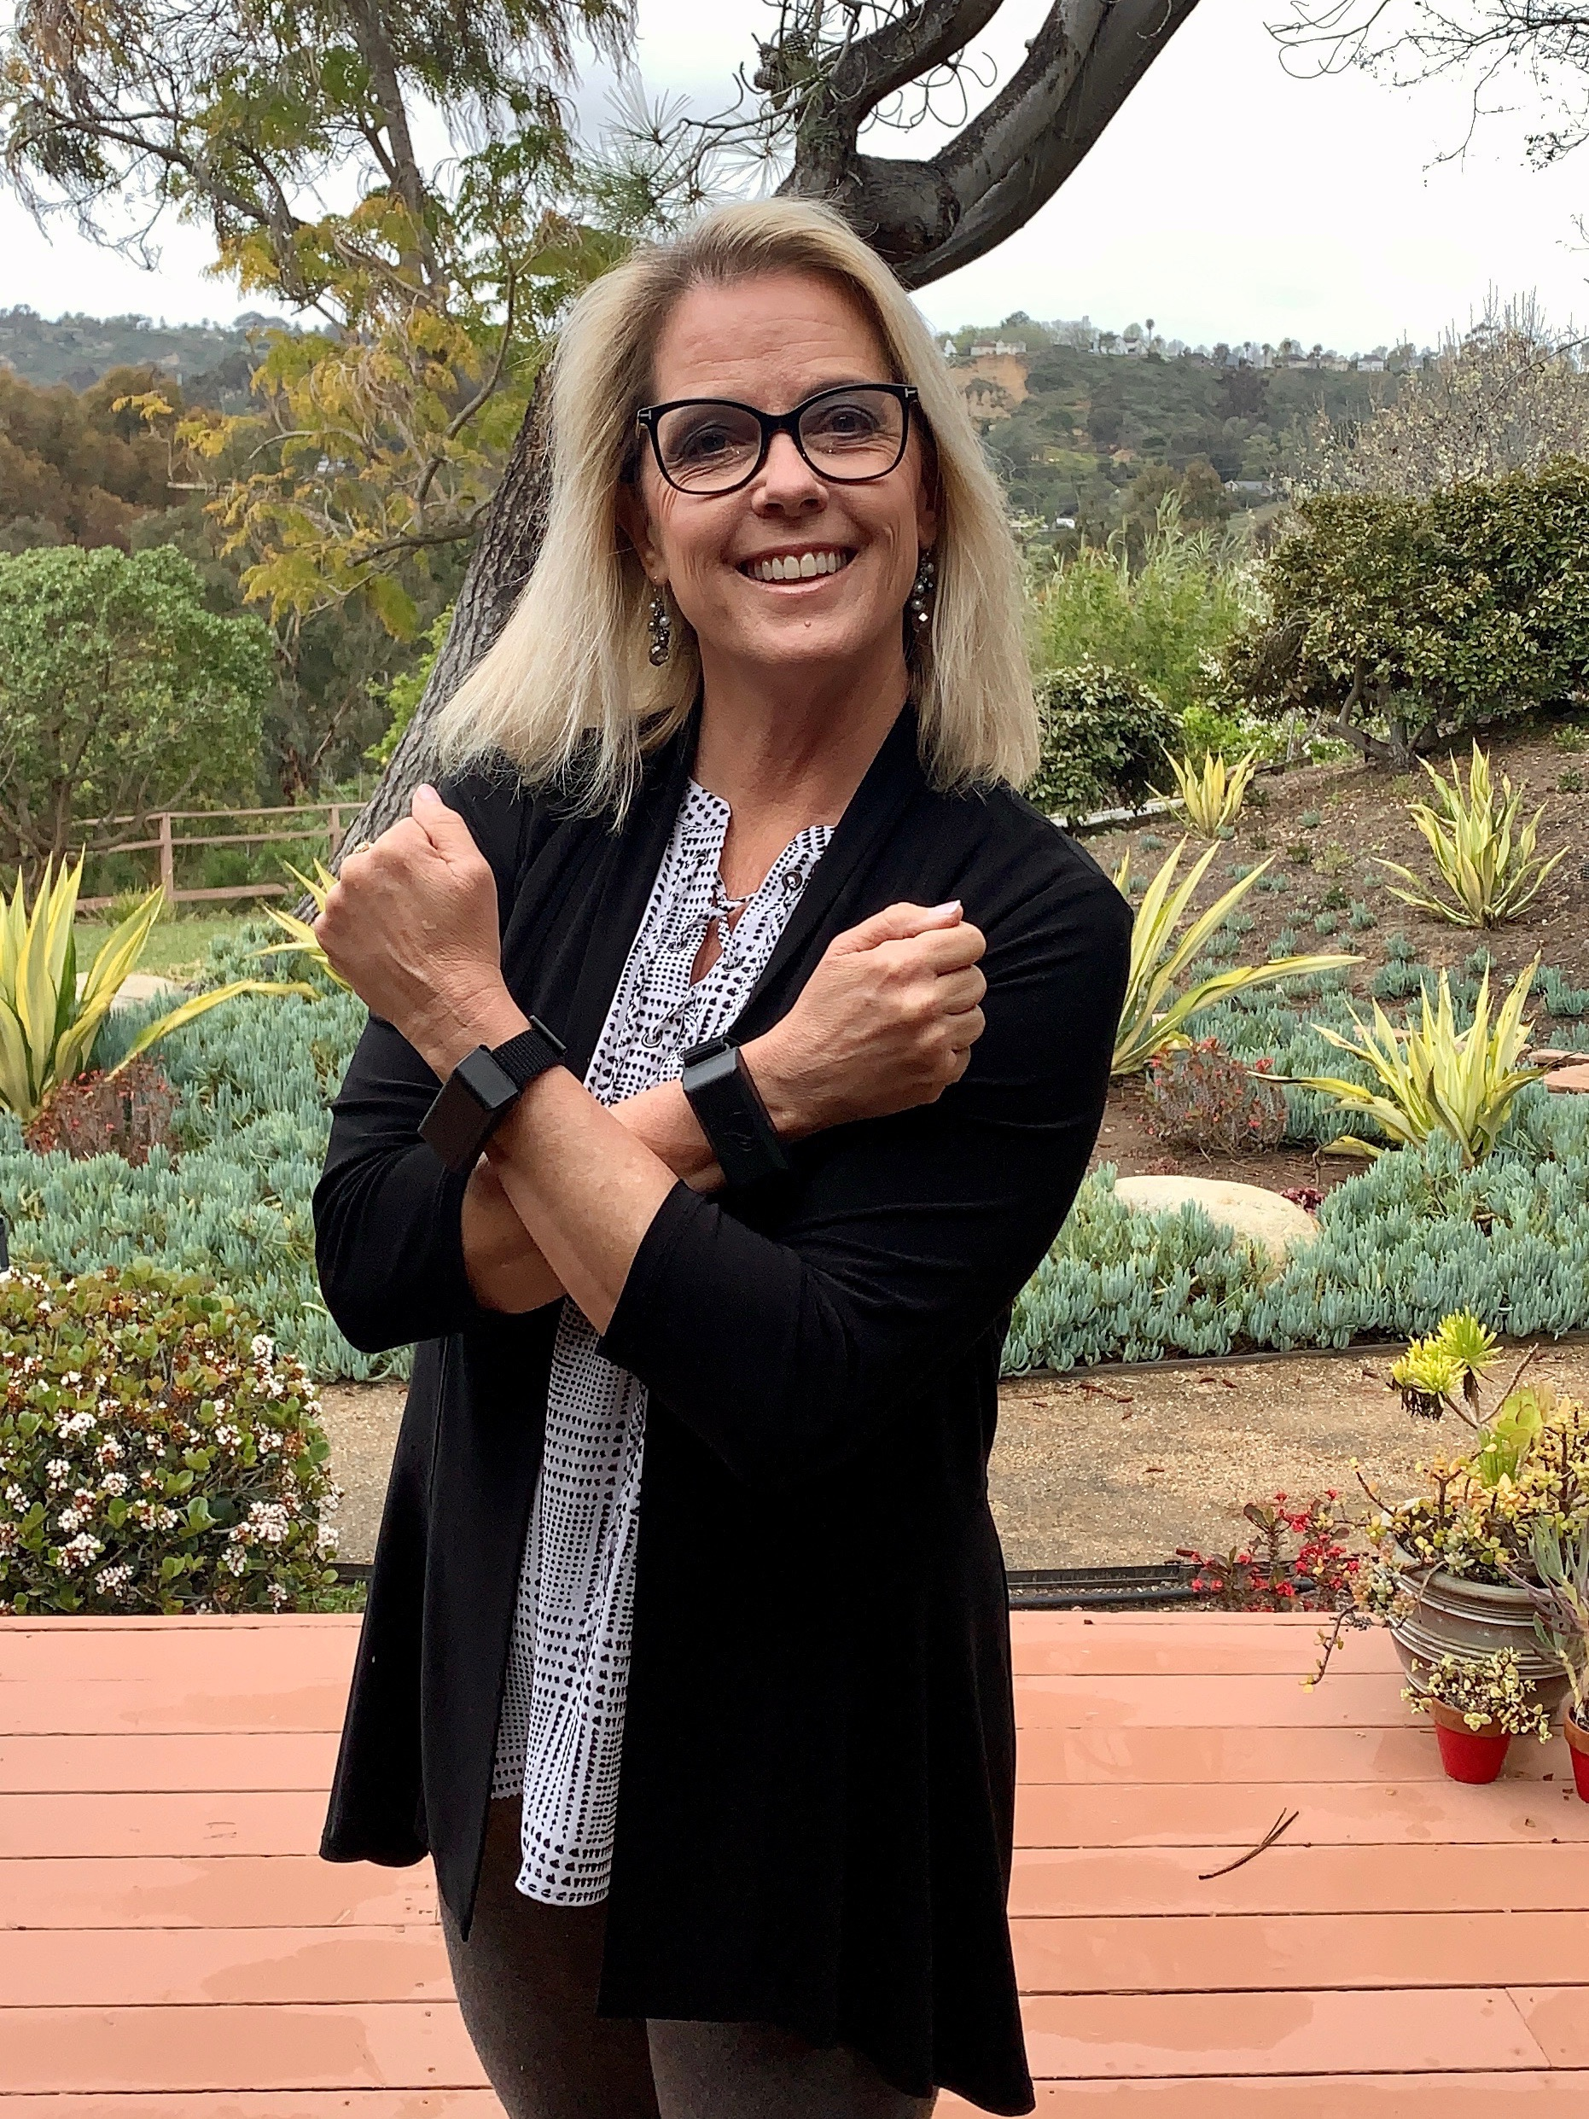
Who’s using Bi-tapps ? Why & When?

Slide 23
how to do a mental health check-up 6 Strategies - STREAM Mike Kyrios
S – Social Networking: too much/too little? Isolation = depression
T – Time-out: quiet time to yourself/everyone needs it.
R – Relaxation: take a break, yoga, breathing, meditation, dancing
E – Exercise & Entertainment: get creative, something new…
A – Alternative Thinking – shift your thoughts/change your channel
M – Mindful of others – checking on others, helping within restrictions
(Neuroscience News & Research 3.26.2020)

Slide 24
Q & A

Slide 25
City Employee Assistance Program
Contact EAP
Assistance includes emotional or work-life counseling, financial information and resources, legal support and resources
877.851.1631 TDD: 800.327.1833
24-hours a day, seven days a week
workhealthlife.com/Standard6

Slide 26
Coherence Associates, inc. www.CoherenceAssociates.com
760.942.8663
Sarag@CoherenceAssociates.com
California Tele-Health Professional Counseling
Offices in San Diego County

