Slide 1
Virtual Three-Part Art Frida Kahlo's Garden

Slide 2
Pre-Tour Activity
Frida's Palette

Slide 3
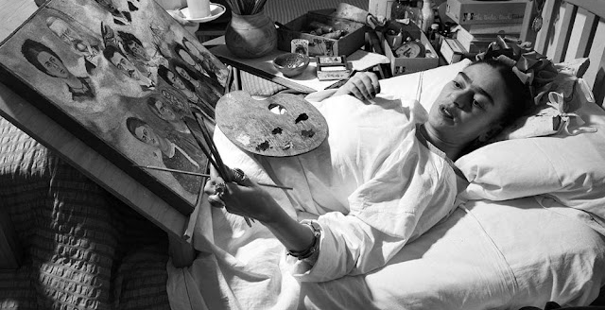
Frida Kahlo painting "Portrait of Frida's Family" in bed.

Slide 4
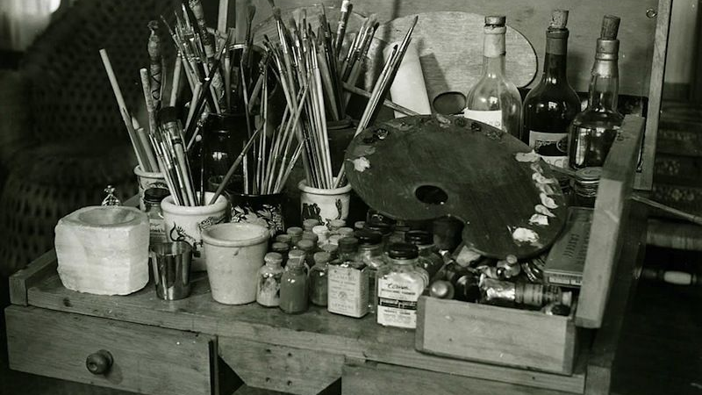
Palette de Frida Kahlo, Mexique, 1952 (Gisèle Freund)

Slide 5
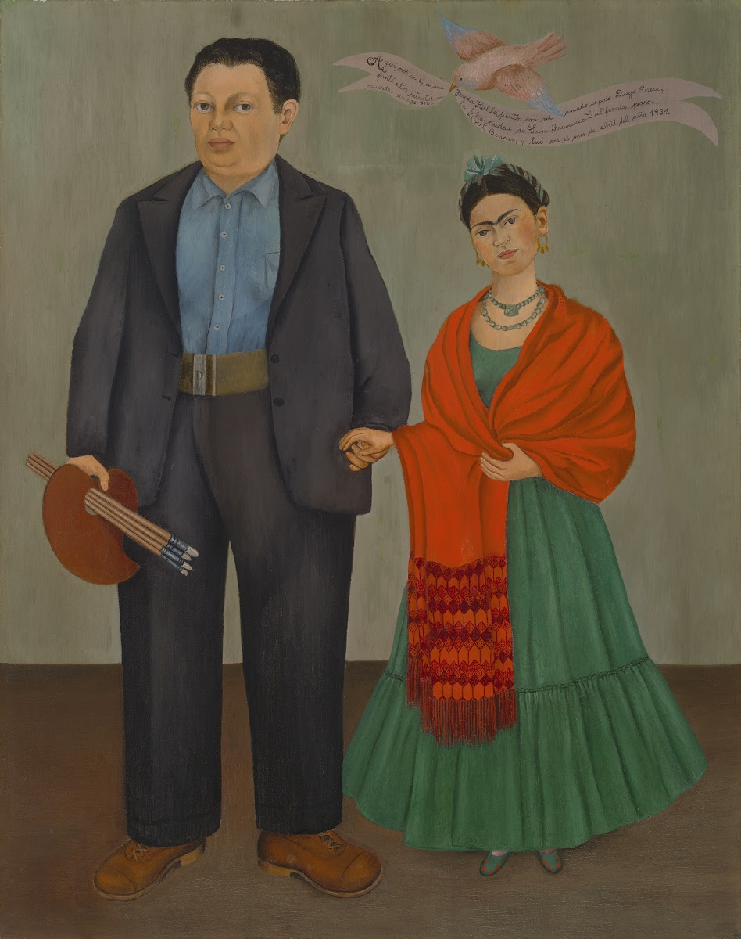
Frieda and Diego Rivera 1931

Slide 6
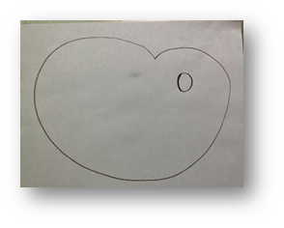
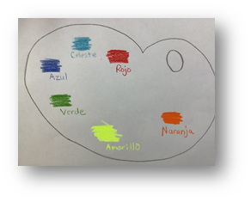
ART EXAMPLE PHOTOS: PART 1

Slide 7
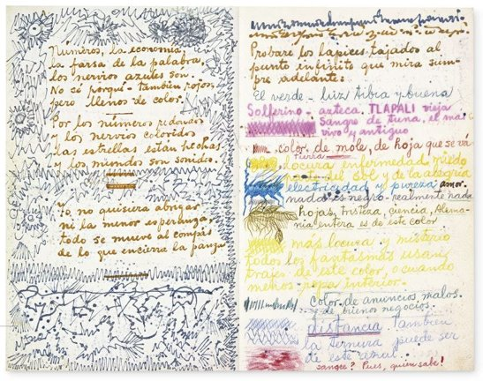
The Diary of Frida Kahlo: An Intimate Self-Portrait (New York: Abrams, 2005)

Slide 8
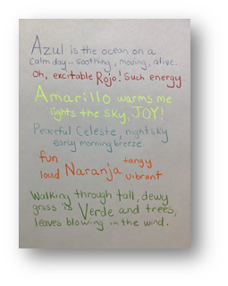
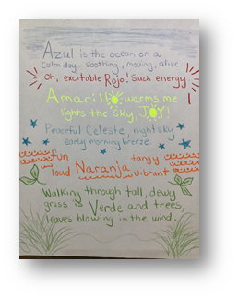
ART EXAMPLE PHOTOS: PART 2

Slide 9
Main Art Lesson
Amate Animalitos

Slide 10
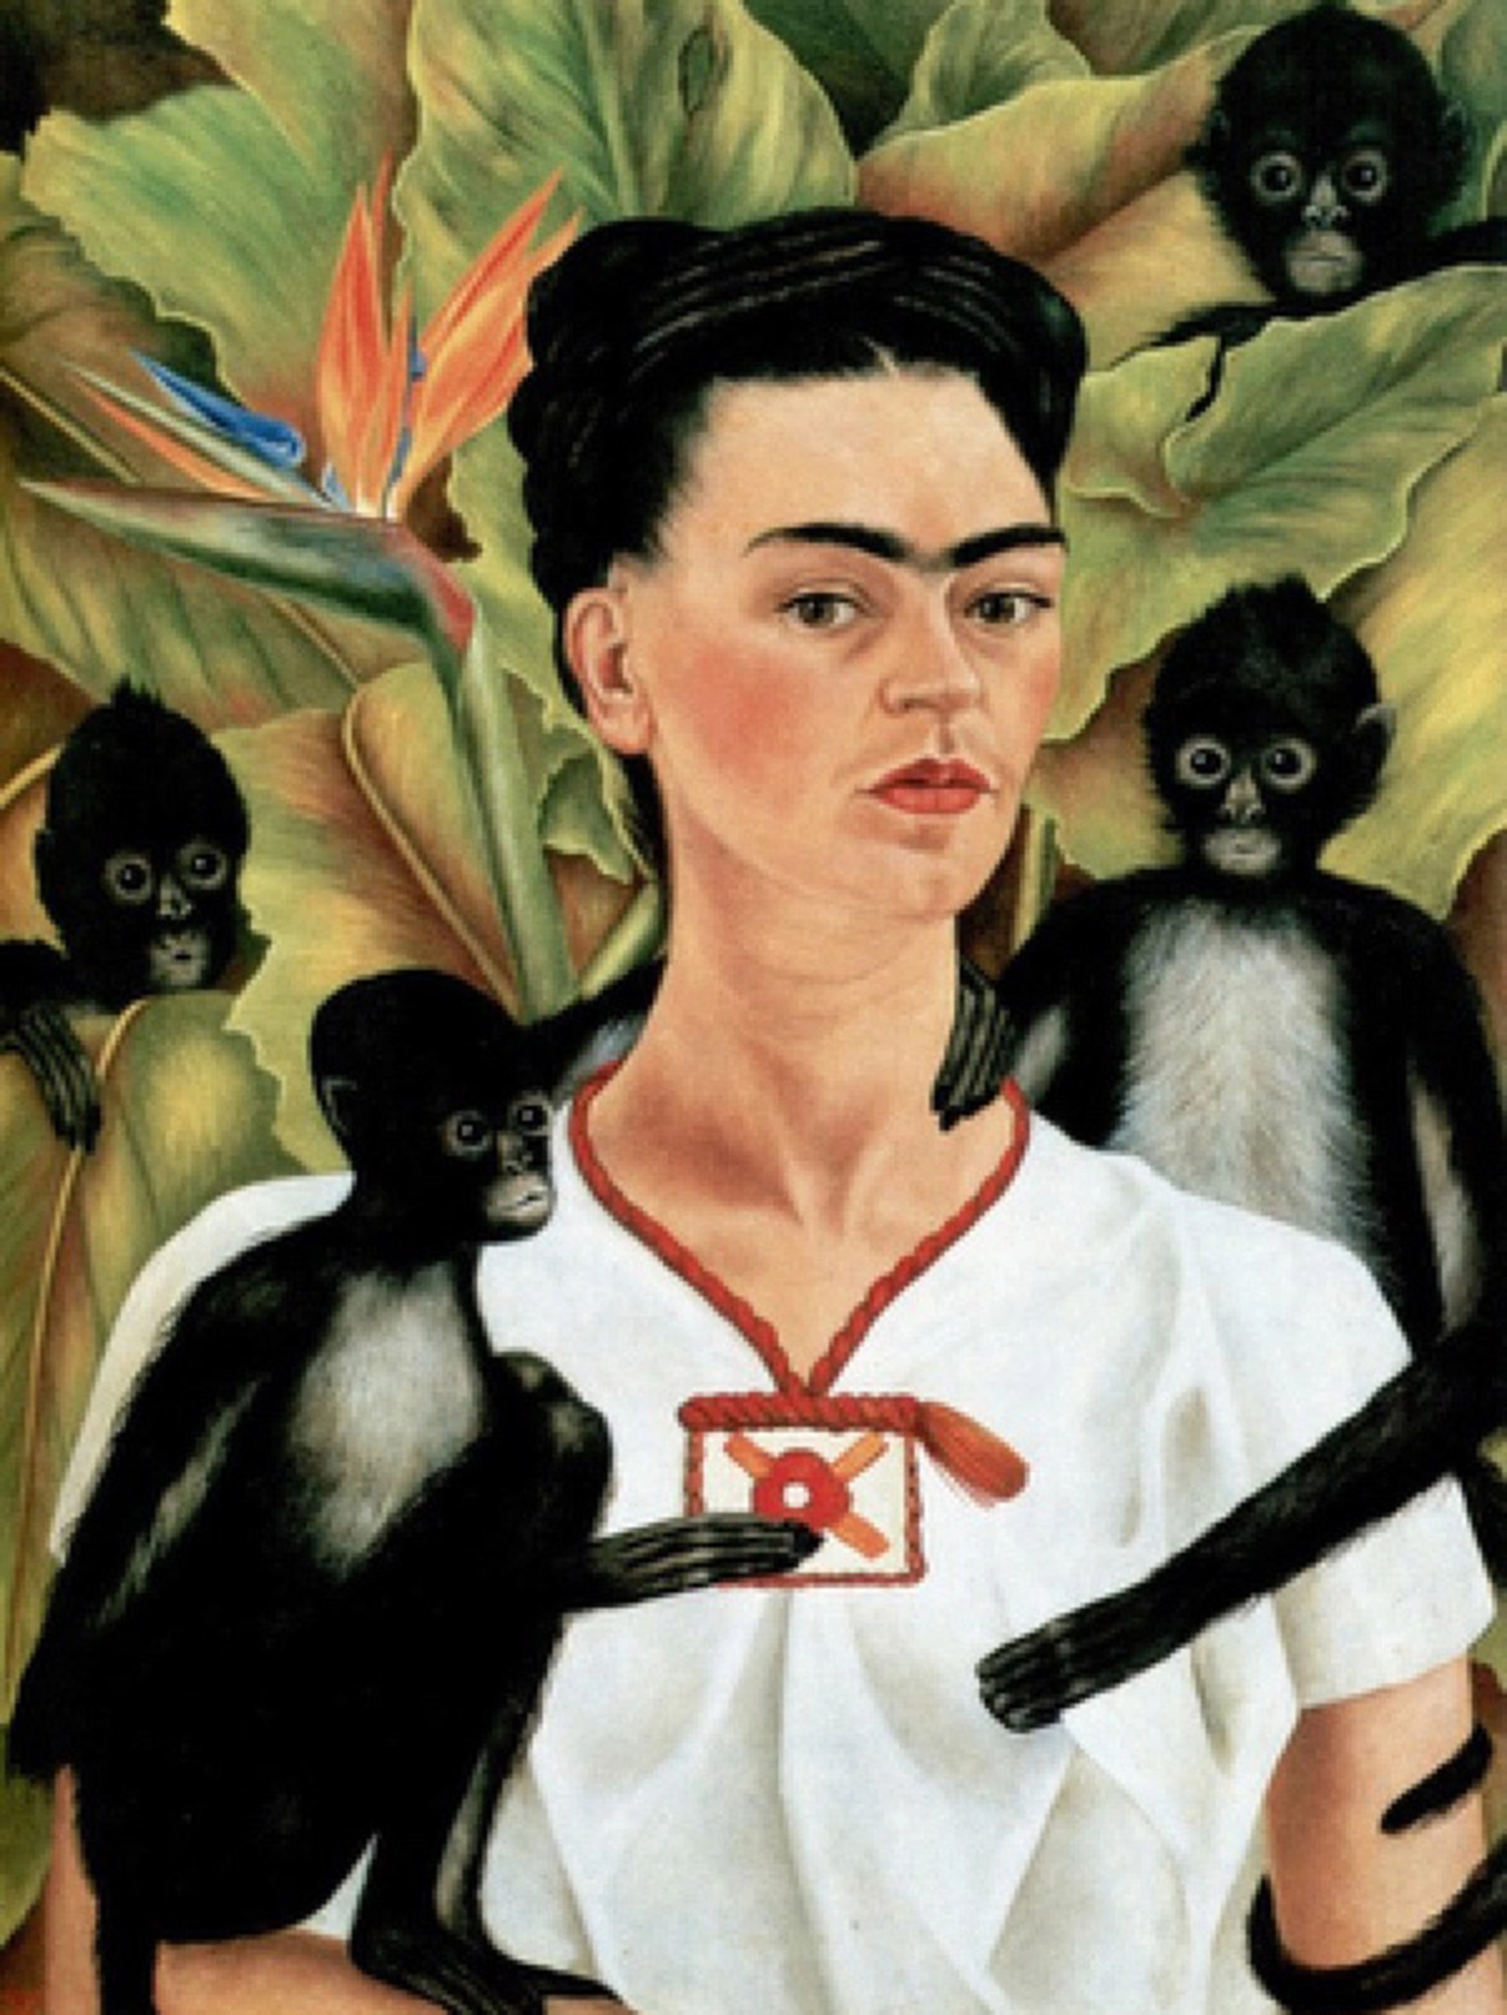
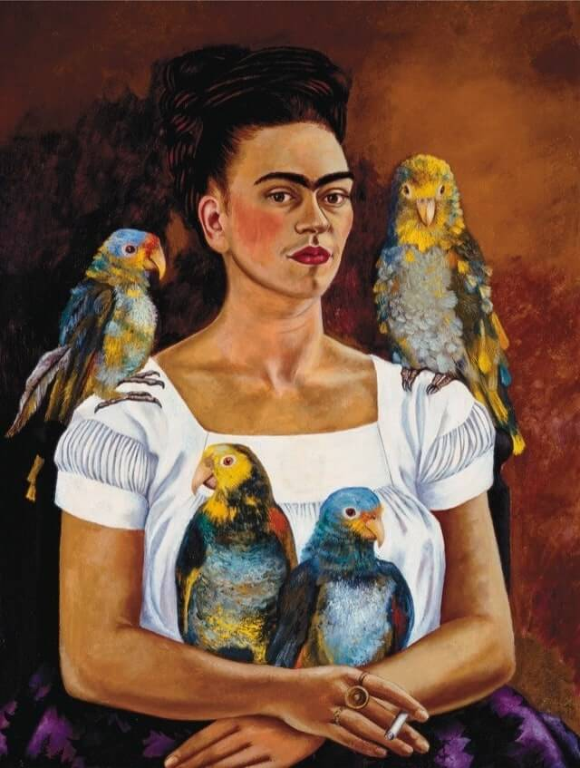
Self-Portrait with Monkeys, 1943
Me and My Parrot, 1941

Slide 11
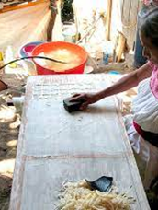
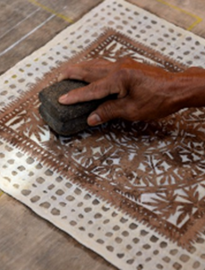
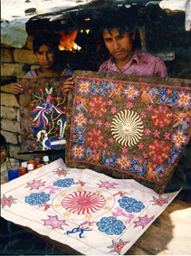
EXAMPLES OF AMATE ARTISANS AT WORK

Slide 12
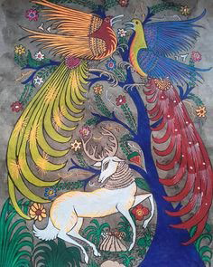
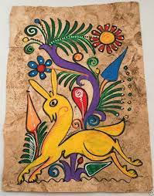
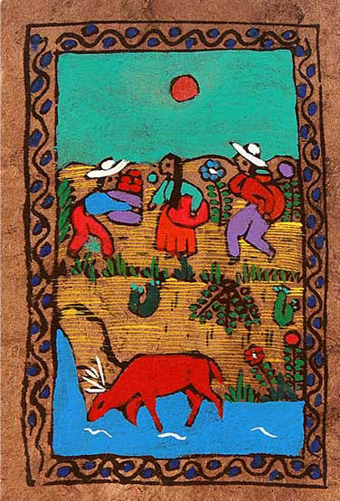
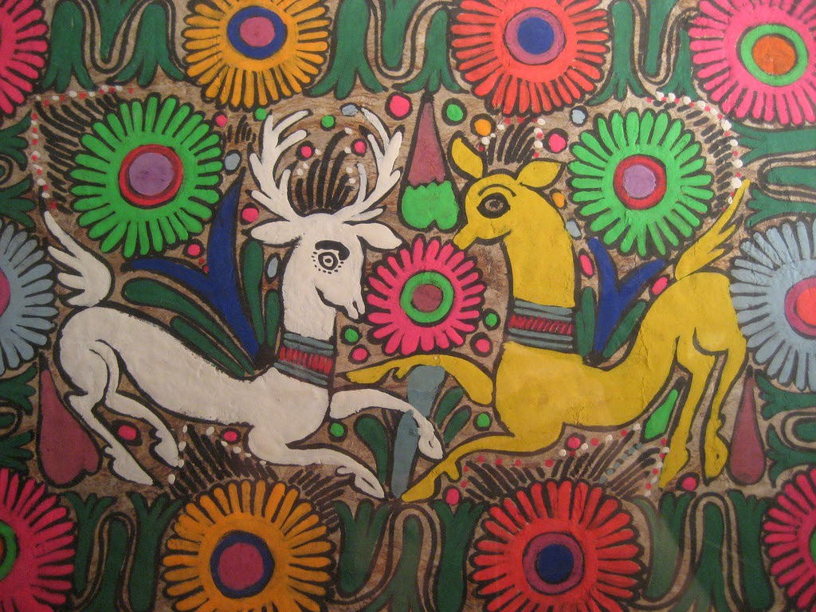
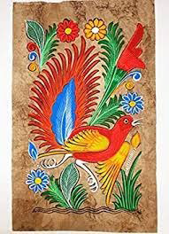
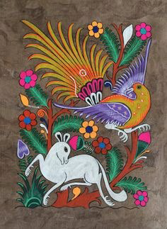
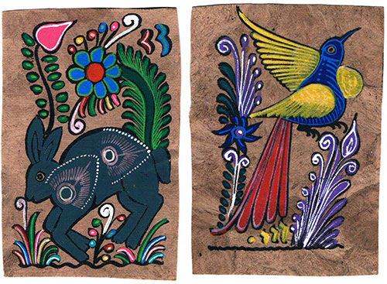
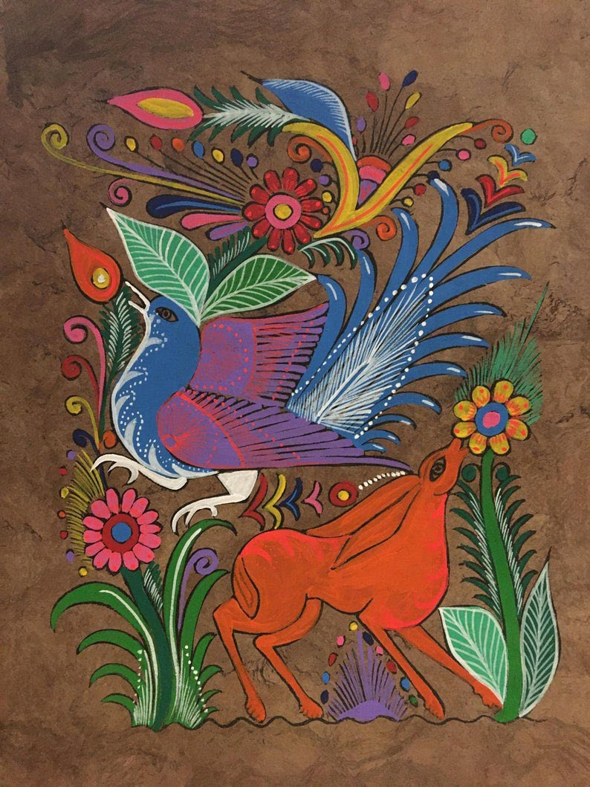
AMATE ART INSPIRATION

Slide 13
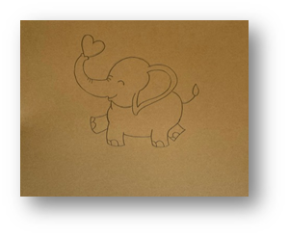
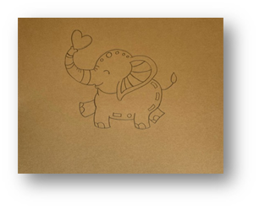
ART PROJECT EXAMPLE PHOTOS
FIG. 1
FIG. 2

Slide 14
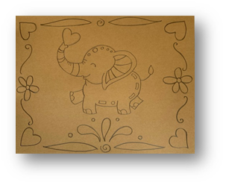
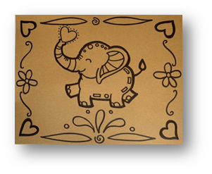
ART PROJECT EXAMPLE PHOTOS
FIG. 3
FIG. 4

Slide 15
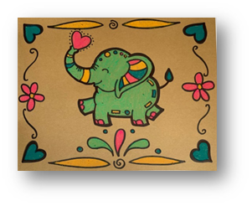
ART PROJECT EXAMPLE PHOTOS
FIG. 5

Slide 16
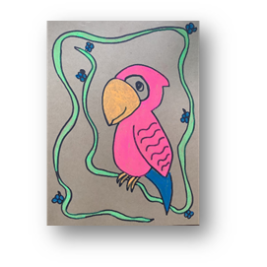
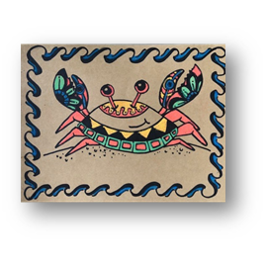
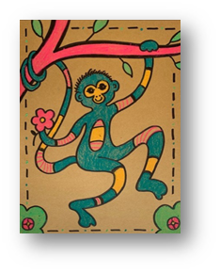
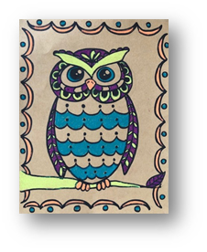
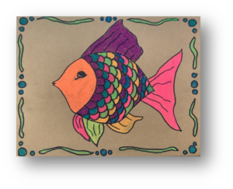
ART PROJECT FINISHED EXAMPLES

Slide 17
Post-Tour Activity
Crazy Collaborative Creatures

Slide 18
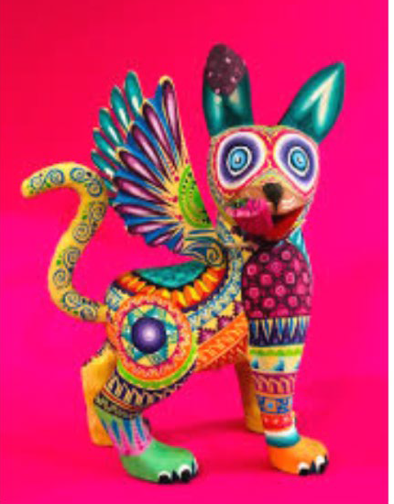
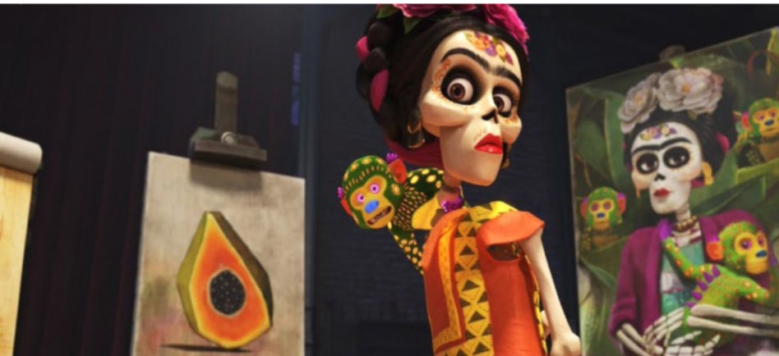
Example of an alebrije
Pedro Linares working on an alebrije.
Frida Kahlo with monkey alebrije. Credit: Pixar’s film, Coco

Slide 19
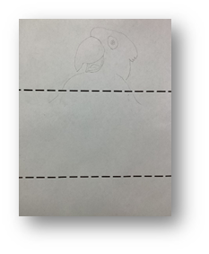
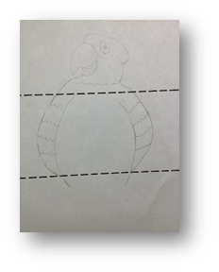
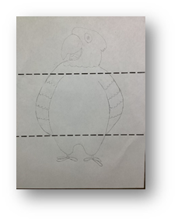
ART ACTIVITY EXAMPLE PHOTOS
FIG. 1
FIG. 2
FIG. 3

Slide 20
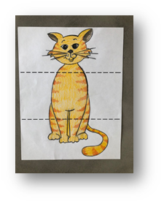
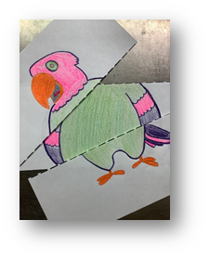
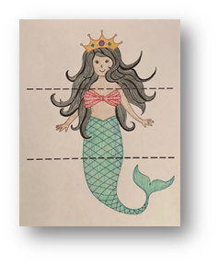
ART ACTIVITY EXAMPLE PHOTOS
FIG. 4
FIG. 4A
FIG. 4B

Slide 21
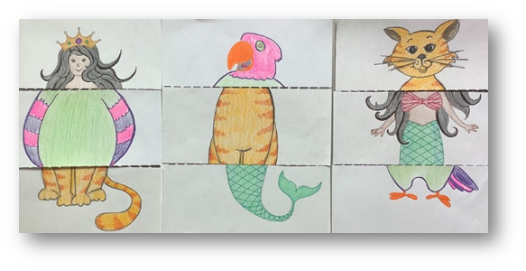
ART ACTIVITY EXAMPLE PHOTOS
FIG. 5

