Slide 1
LGBTQI+
Presented by:
Corporal Natali Fant
LGBTQI+ Community Liaison

Slide 2
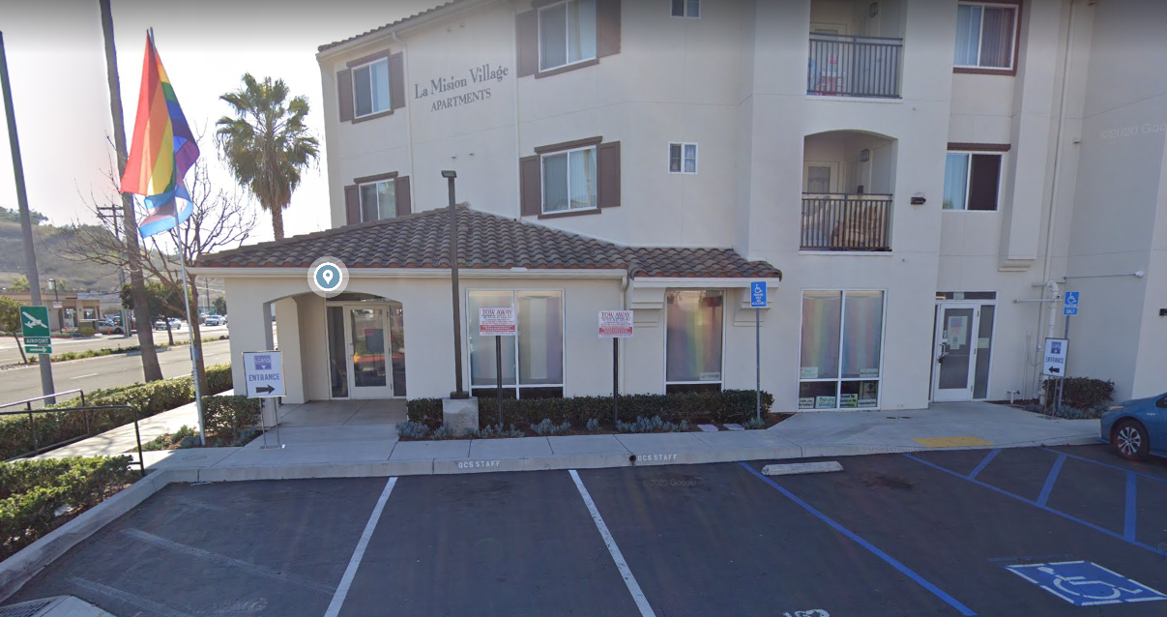
North County LGBTQ Resource Center
3220 Mission Ave.#2, Oceanside, Ca. 92058
(760)994-1690
Max Disposti
Executive Director & Founder NC-LGBTQ Resource Center

Slide 3
Training goals
Understand and define the difference between sex and gender, sexual orientation and gender identity.
Discuss the health threats unique to LGBTQ population.
Provide best practices for creating LGBTQ-safe space with law enforcement.

Slide 4
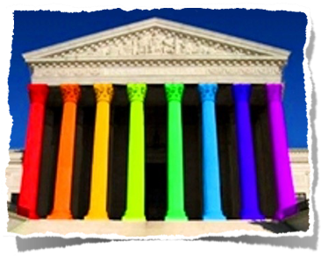
California Guidelines
In California: Gender Identity, Sexual Orientation & Gender Expression, are fully protected by the law.
LGBT A-Z Glossary | North County LGBTQ Resource Center (ncresourcecenter.org)

Slide 5
Definitions
Sex: the classification of people as male or female. At birth, infants are assigned a sex based on a combination of bodily characteristics including chromosomes, hormones, internal reproductive organs, and genitals.
Gender: One’s internal, personal sense of being a man or a woman (or a boy or a girl). For transgender people, their birth-assigned sex and their own internal sense of gender identity do not match.
Gender Expression - External manifestation of one’s gender identity, usually expressed through “masculine,” “feminine” or gender-variant behavior, clothing, haircut, voice or body characteristics. Typically, transgender people seek to make their gender expression match their gender identity, rather than their birth-assigned sex.
Sexual Orientation - Physical and/or emotional attraction for the same or opposite sex.
LGBT A-Z Glossary | North County LGBTQ Resource Center (ncresourcecenter.org)

Slide 6
Definitions Cont’d
Intersex - Describing a person whose biological sex is ambiguous. There are many genetic, hormonal or anatomical variations that make a person’s sex ambiguous, such as Klinefelter Syndrome). Parents and medical profession­als usually assign intersex infants a sex and perform surgical operations to conform the infant’s body to that assignment. This practice has become increasingly controversial as intersex adults speak out against. The term intersex is not interchangeable with or a synonym for transgender.
Transgender - An umbrella term (adj.) for people whose gender identity and/or gender expression differs from the sex they were assigned at birth. The term may include but is not limited to: transsexuals, cross-dressers and other gender-variant people. Transgender people may identify as female-to-male (FTM) or male-to-female (MTF) so use the descriptive term (transgender, transsexual, cross-dresser, FTM or MTF) preferred by the individual. Transgender people may or may not decide to alter their bodies hormonally and/or surgically.
LGBT A-Z Glossary | North County LGBTQ Resource Center (ncresourcecenter.org)

Slide 7
SB179
SB179 – On October 5th, 2017, the governor of California signed SB179 into law. This bill was labeled Gender identity: female, male, or nonbinary. This amended several code sections in California Law, including Section 12800 of the Vehicle Code, which is the code section for California Driver’s Licenses and California Identification cards. For nonbinary individuals this will appear and an “X” in as the gender marker on the face of the license or ID card.

Slide 8
LGBTQ+ and Law Enforcement
Historic discriminatory practices in the past that have caused mistrust and fear to ask for help.
Homelessness (40% of homeless youth are LGBTQ)
Mental health (Suicide)
Substance abuse
Sexual assault
Family violence
Melissa Moore: 40% of Homeless Youth Are LGBTQ – What We Can Do | TED Talk

Slide 9
Best practices
Always use a transgender person’s chosen name. Often transgender people cannot afford a legal name change or are not yet old enough to change their name legally. They should be afforded the same respect for their chosen name as anyone else who lives by a name other than their birth name (e.g., celebrities).
Whenever possible, ask transgender people which pronoun they would like you to use. A person who identifies as a certain gender, whether or not that person has taken hormones or had some form of surgery, should be referred to using the pronouns appropriate for that gender.
If it is not possible to ask a transgender person which pronoun he or she prefers, use the pronoun that is consistent with the person’s appearance and gender expression. For example, if a person wears a dress and uses the name Susan, feminine pronouns are appropriate.
It is never appropriate to put quotation marks around either a transgender person’s chosen name or the pronoun that reflects that person’s gender identity.
When describing transgender people, please use the correct term or terms to describe their gender identity. For example, a person who is born male and transitions to become female is a transgender woman, whereas a person who is born female and transitions to become male is a transgender man.
LGBT A-Z Glossary | North County LGBTQ Resource Center (ncresourcecenter.org)

Slide 10
Safe space
Do not assume heterosexuality
Do not assume sex or gender based on exteriors
Respect a person’s pronouns even when their ID has a different name.
Respect confidentiality of the person to avoid HIPPA violations
Share gender identity of the individual only when necessary (e.g. jail, Fire, P.E.R.T)
Ask the person what pronouns they would like to use.
Offer services (NC-LGBTQ+ center)

Slide 11
Trans Story
The Whittington Family: Ryland's Story - YouTube

Slide 12
Questions?

