Slide 1
Carlsbad PD Naloxone Training Program
Intranasal Administration of Naloxone for Suspected Opiate Overdose

Slide 2
Objectives
Overview of the problem
What is an Opiate
Side effects
Overdose indicators
What is Naloxone (Narcan)
Intranasal application & administration
Side effects
CPD program & reporting procedures

Slide 3
Background
Alarming rise in unintentional opioid related deaths.
Some opioids are prescription medications.
Illicit drugs – Fentanyl, heroin, etc.
Law enforcement officers are at risk of being exposed.
Fentanyl, in powder form, can be absorbed through the skin* or inhaled.

Slide 4
Carlsbad Stats
CFD Narcan Administration, YTD
2018 – 3
2019 – 9
2020 – 13
2021 – 40 (as of March 2021)
Instances of exposure to officers at neighboring agencies. (SDSO/EPD)

Slide 5
AB2256 - 2018
Authorized administration of naloxone by law enforcement agencies
Must complete training
Must document usage and maintain for 3 years
Must monitor supply and ensure destruction of expired medication
Also covered by Good Samaritan if performed in accordance with training, etc.

Slide 6
CBPD Policy
CBPD 468.8 Administration of Opioid Overdose Medication
Training on use/administration
Storage
Easily accessible in patrol vehicles
Temp >41 F and <104 F
Expiration
Expires within 36 months
Check at start of shift and at quarterly squad inspections

Slide 7
Officer Safety
Officer safety is paramount
Scene safety and security take precedence.
All responding officers take Narcan into scene
There was a substance present that caused the overdose – possibly accidental exposure.
Utilize buddy system when handling or processing controlled substances.
Notes:
Understanding that someone else may be in dire condition you still must be sure that you are safe prior to any potentially life saving intervention. This includes the administration of a potentially life saving drug or CPR.

Slide 8
Opiates
Synthetic or naturally occurring
Binds with receptors in the brain
Induce sedation
Block perception of pain
Serve a medicinal purpose
Pain management
Comfort measures
Notes:
Opium has been cultivated since 3400 BC, first used as a “narcotic” sleeping agent by Hippocrates. Paracelsus used opium as a pain killer during the Renaissance.

Slide 9
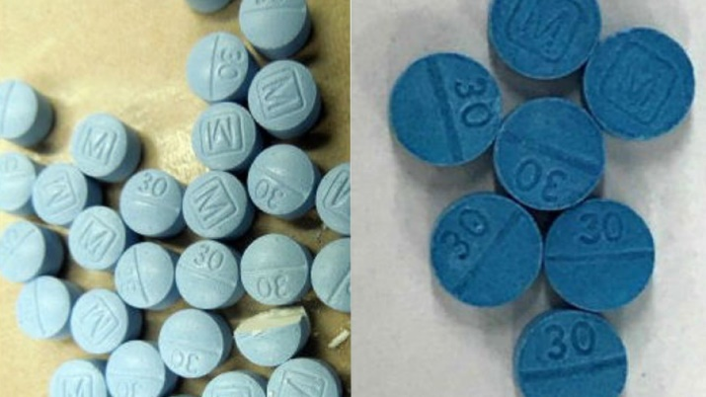
Opiates of Abuse
Fentanyl
Heroin
Opium
Codeine
Morphine
Tramadol (Ultram)
Methadone
Buprenorphine (Subutex)
Propoxyphene (Darvocet)
Pethidine (Demerol)
Hydrocodone (Lortab/Vicodin)
Oxycodone (Percocet, Oxycontin)
Hydromorphone (Dilaudid)
Oxymorphone (Opana)

Slide 10
Fentanyl
Schedule II Narcotic Analgesic/anesthetic
Most potent opioid available for medical use.
50-100 times more potent than morphine.
30-50 times more potent than heroin.
Potentially lethal at low levels. 0.25mg
Can be absorbed through skin* and accidental inhalation.
Has been detected in Meth, Heroin, Cocaine, etc.

Slide 11
Side Effects of Opiates
Euphoria
Sedation
Decreased respiratory rate
Pin point pupils
Meperidine (Demerol), and Propoxyphene (Darvon) Will cause dilated pupils
Notes:
Abusers and recreational users seek the euphoric effects of opiates. Once the dependency is established they need higher and higher doses to achieve the desired effects. Abusers of prescription opiates often make the jump to illicit opiates.

Slide 12
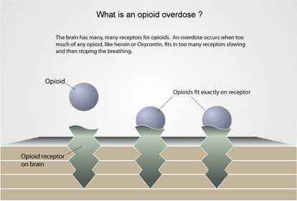
Overdose Indicators
Decreased level of consciousness
Unconsciousness
Pin Point or Dilated pupils*
Sweaty / Clammy
Decreased respiratory rate
Cardiac arrest
Notes:
The individual cannot be aroused by shaking, or other noxious stimuli. Normal respiratory rate for an adult is 12-20 breaths per minute. When rates become too slow and too shallow the risk for hypoxia increases. In cases of cardiac arrest CPR will need to be initiated.

Slide 13
Hypoxia
Ineffective breathing
Less than 6 breaths per minute
Normal respiration rate 12-15 breaths/min.
Lack of oxygen to the vital organs
Hypoxic brain injury can occur within 4 to 6 minutes
Pupillary dilatation
Cyanosis a pale, or bluish color
Lips
Nail beds

Slide 14
Typically, When Does an Overdose Occur?
High potency heroin
Poly substance abuse
Decreased tolerance after period of abstinence; release from jail, relapse after detox/recovery.
Accidental exposure
Notes:
Overdoses occur when the patient injects or snorts high potency heroin.
Or
When a person takes alcohol, benzodiazepines (Valium) in addition to heroin can cause someone to overdose because valium, alcohol, and heroin all cause respiratory and CNS depression.
Or
Persons who have a decreased tolerance after abstinence, such as release from jail, or relapse after detox or recovery.

Slide 15
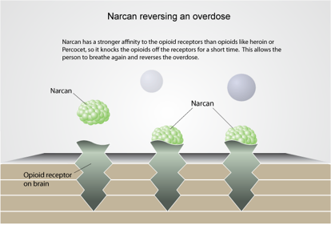
Narcan (Naloxone)
Opioid antagonist
Reverses opioid overdose by competing for opioid receptors in the CNS
Onset of action 1 to 2 minutes
Given intranasal
Low risk for blood borne exposure
No risk if given in absence of opioids

Slide 16
Narcan (Naloxone)
Primary goal for administration is to increase respiratory rate and further reduce or prevent damage caused by hypoxia.
Not intended for total reversal
Multiple doses may be required
Notes:
Although it is possible to fully reverse the overdose that is not the intent. The goal is to increase the individuals respiratory rate to closer to normal. Many in the medical community are supporting the idea of letting the individual gradually wake up in a controlled environment.

Slide 17
Intranasal Medication Administration: Basic Concepts
This delivery route has several advantages:
Its easy and convenient
Almost everyone has a nose
The nose is a very easy access point for medication delivery
No special training is required to deliver the medication
No shots are needed
It is painless
It eliminates any risk of a needle stick to you, the medical provider

Slide 18
Administer 4mg Naloxone in either nostril
Administer 4mg Naloxone in either nostril

Slide 19
Side Effects of Full Reversal
Agitation, confusion, hostility
Vomiting
Profuse sweating
Cardiac arrest (rare)
Notes:
Most common side effects of full reversal is vomiting which poses its own threat of aspiration of vomit. Agitation, confusion, and hostility are fairly common also and make the individual more difficult to medically manage. Cardiac arrest can occur particularly in the long time abuser. Their bodies are adapted to functioning in an intoxicated state. The abrupt reversal “shocks” the system and is unable to compensate for the lack of opiates. This is more likely to occur when narcan is given in large doses IV.

Slide 20
Naloxone has no effect on…
Benzodiazepines
Sympatometics
Marijuana
Sleep agents
Alcohol
Most users, whether recreational , habitual, or accidental have ingested two or more substances.
Notes:
Common benzodiazepines are alprazolam(xanax), diazepam(valium). Anti-seizure medications. Sympatometics (cocaine, add medications)Narcan will have no effect on sleep agents either.

Slide 21
Overdose Mimics
Strokes
Hypoglycemia (low blood sugar)
Infection

Slide 22
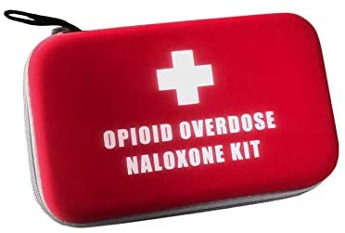
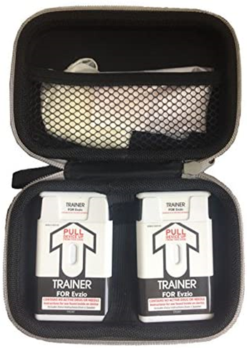
CBPD Kits
Narcan serial number placed inside elastic mesh

Slide 23
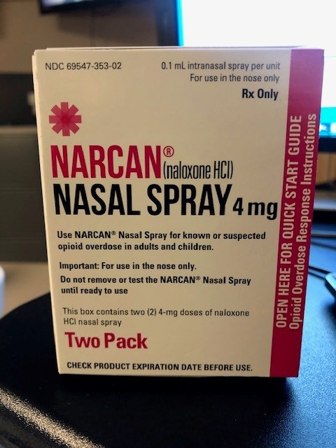
Intranasal Naloxone (Narcan)

Slide 24
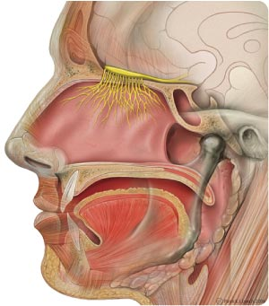
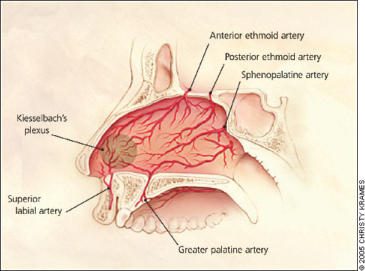
Basic anatomy of the nose
Blood vessels
Olfactory Bulb
Notes:
The nasal cavity is rich in blood vessels. They are capable of absorbing medication easily and delivery the medication directly into the blood supply. There is good evidence to support that if the medication comes into contact with the olfactory mucosa that the medication can pass into the CNS.

Slide 25
Barriers to absorption
Prolonged abuse (scar tissue)
Nasal discharge
Use of vasoconstrictors
Debris (dust, powders)
Trauma
Too much volume delivered
Notes:
Prolonged abuse of inhaling opiates, cocaine, methamphetamine damage the structures of the nose reducing the ability for absorption to occur. Nasal discharge that is thick and viscous will reduce absorption since it acts like a barrier. Nasal decongestants constrict the blood vessels. Trauma to the nose with bleeding also decreases absorption. One will need to exercise caution in the setting of severe nasal/facial trauma due to the potential for cervical spine injury. Too much volume delivered will washout not achieving the desired effect.

Slide 26
Prehospital Intranasal Naloxone
Take away lessons for nasal naloxone:
Dose and volume – 4mg in either nostril.
Delivery – Inject Naloxone into nose with MAD, then begin standard care. Recovery position.
Successful awakening or Effective breathing eliminates the need for more of Naloxone. Continue supportive care and await EMS.
Awakening is gradual and occurs in 1-3 minutes.
Not 100% effective so failures with intranasal naloxone need to be followed by one additional dose after 3-5 minutes.

Slide 27
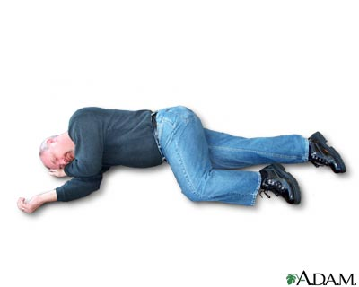
Recovery position

Slide 28
CBPD Naloxone Program
CBPD Policy - Lexipol
PD HQ will have kits placed at potential exposure sites & all First Aid stations
Replacements in W/C Office
Professional Standards and Services Bureau (PSSB) responsible for rotating inventory, ordering/replacing and monitoring/tracking

Slide 29
Reporting Procedures
468.8.2 OPIOID OVERDOSE MEDICATION REPORTING
Any member administering opioid overdose medication should detail its use in an appropriate report.
Officers shall document the circumstances surrounding the use of naloxone. The report shall include the serial number(s) of the naloxone used as well as identifying information for the assisted person.
Supervisors will be responsible for ensuring that the Records Manager is provided enough information to meet applicable state reporting requirements. The Professional Standards and Services Bureau will conduct a bi-annual audit of naloxone on the deployment and effectiveness of the product.

Slide 30
Reporting Procedures
Document administration of Narcan in IR:
The nature of the incident;
Symptoms observed indicative of OD
The fact that Narcan was administered
The care the patient received
SPECIAL STUDIES: NARCAN-PD Administered

Slide 31
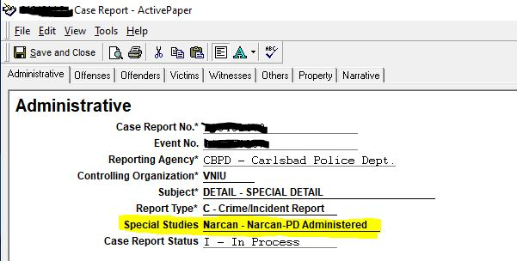
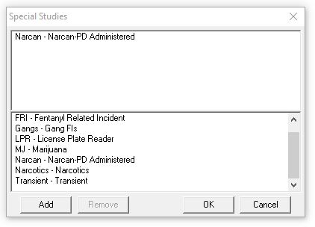
Reporting Procedures

Slide 32
Sample Verbiage
Responded to the report of an overdose. Arrived on scene to find a 36 year old male laying on the ground unconscious and unresponsive with ineffective breathing. Family on scene states the patient has a history of opiate abuse. Upon assessment the patient was found to be pale and sweaty, with pinpoint pupils and breathing at a rate of 4 breaths per minute. The patient was found to have no outward signs of trauma. The patient was administered 2mg of Narcan intra nasal in the left nostril. The patient's breathing rate increased and the patient's mental status improved. the patient was transported to Scripps Encinintas and vital signs were monitored en route to the hospital.

Slide 33
Conclusion
Like tourniquet – For you first!
LE are often on scene before EMS
Primary goal is to restore effective breathing
No negative side effects of administration
Practice buddy system when handling/processing controlled substances
Current trends of opiate use and abuse support the need of this program.

