Slide 1
Three Part Art Program
Grades 6-8
William D. Cannon Art Gallery Exhibit:
Reimagined: The Artist’s Book Feb. 26 – May 14, 2022
Inspiration Artist: Amandine Nabarra

Slide 2
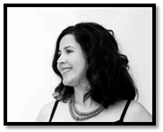
Inspiration Artist: Amandine Nabarra
I love to give presentations to inspire my audience to create their own art projects because I know how it feels to repress one’s calling. I explain how hard and yet exciting the art journey is. I share tips to stay focused and I encourage listeners to think big. - Amandine Nabarra
Photo by OC Art Blog

Slide 3
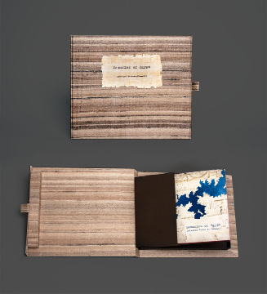
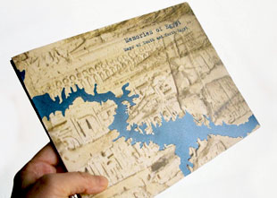
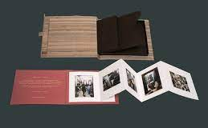
Memories of Egypt,
2011
8.6 inches x 6.75 inches; 12 pages. Modified double-sided accordion structure. One side has two Egyptian map folds, each sitting in the valley fold of the main structure, 15 3/4 inches x 15 3/4 inches. The other side is a more conventional accordion with 6 panels of photographs sitting in the valley fold of the main structure, 7 1/2 inches x 6 inches, open: 35.5 inches x 6 inches. Printed offset.
Both covers treated with a sand texture and embossed
Slipcase: Book slipped into matching full band with printed title, which then fits into an opaque envelope
Box: 10 inches x 10.5 inches. Cloth-covered custom box with snap closure and papyrus title label that contains a smaller hard-sided pop-up holder that book slips into

Slide 4
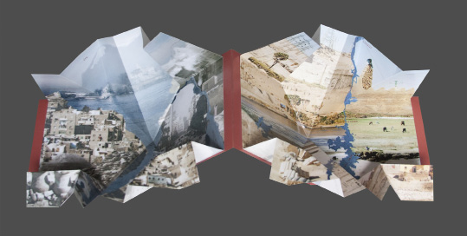
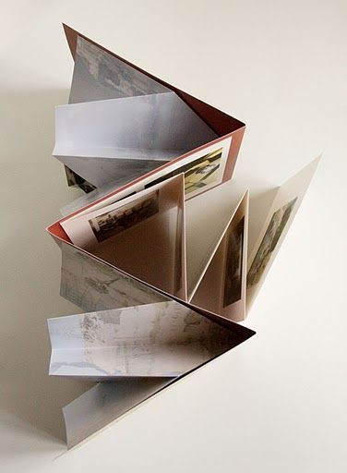
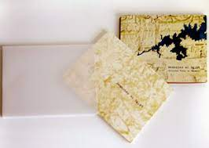

Slide 5
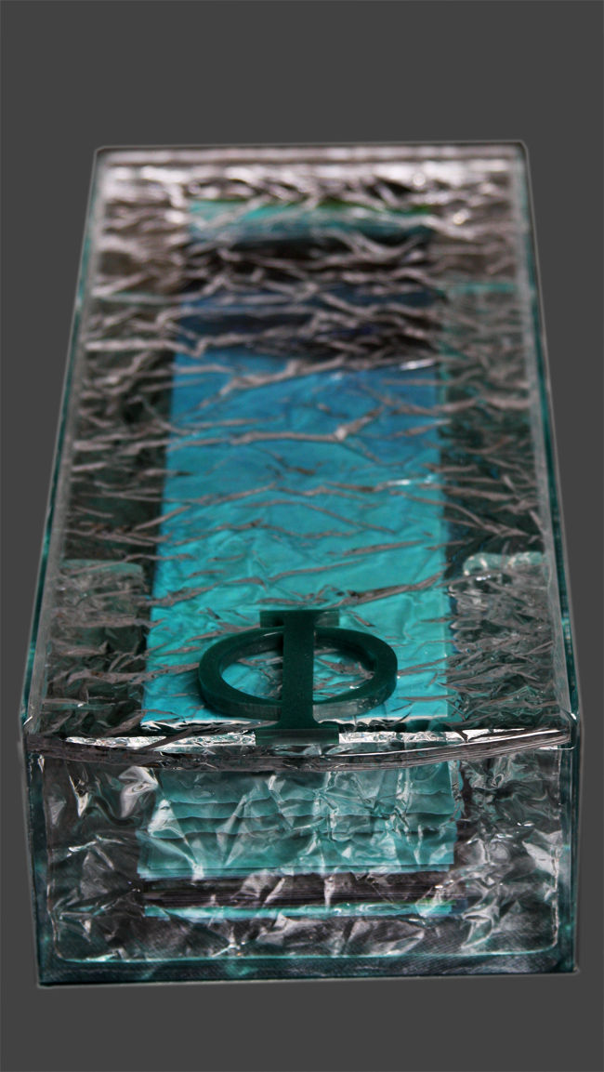
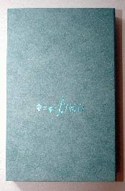
Bernoulli Equation, 2011
71 leaves in PVC sewn with nylon thread of 3 1/4 inches x 13.4 inches closed, 98.4 inches x 13.4 inches open
Box 5.7 inches x 14.4 inches in Plexiglass with a "phi"

Slide 6
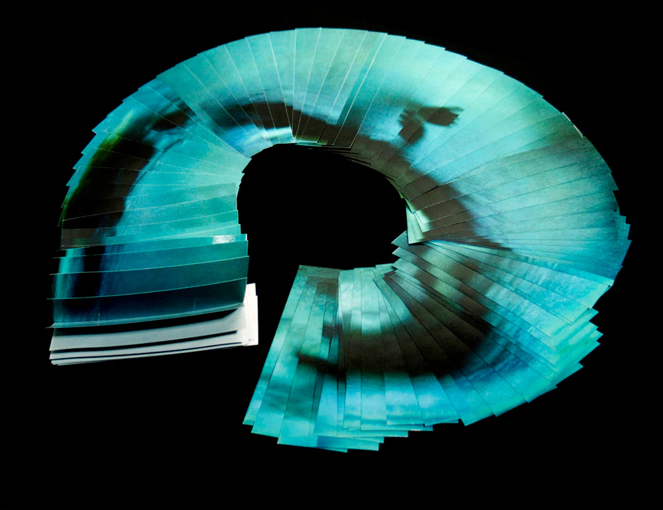
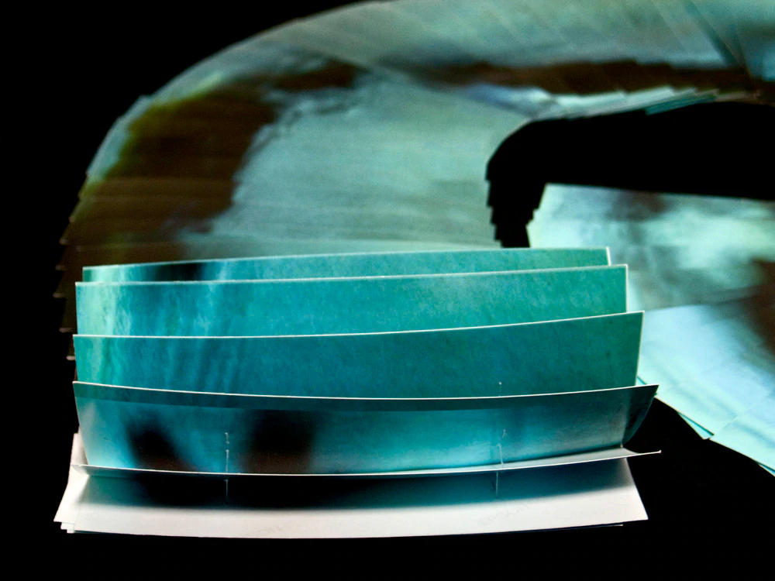

Slide 7
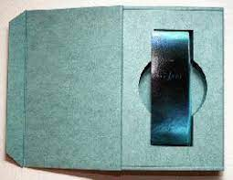
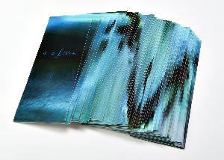
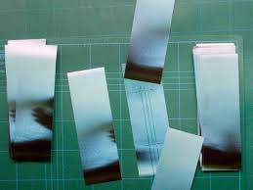

Slide 8
Amandine Nabarra is an artist and entrepreneur working across artistic mediums who shares her vision of the world through photographs and artist’s books. Amandine creates spaces to tell visual stories that readers experience by themselves. In these works, people, places, and objects connect in unexpected ways to create a tale that can be read as fragments or in their entirety. Amandine was awarded the Purchase Award for Bookopolis (2017), the Best of Show award for Wunderlust (2016), the Gallery Director’s Exhibition Award for the Photo Book Works exhibit in Colorado (2013). She was also the recipient of the Masquelibros prize in Madrid, Spain and Familiar Relics in Nashville, USA (2012). She has exhibited in numerous photography and artist’s book shows in the USA, Europe and Australia. Her work is in over 40 private and public collections like Le Centre Pompidou in France, The Getty Research Center in Los Angeles, and the Art Institute of Chicago, among others. She lives and works in Los Angeles and is the founder of Bazooka Grooves.
- excerpted from https://anpfotos.com/
Photo by Fanny Chu

