Slide 1
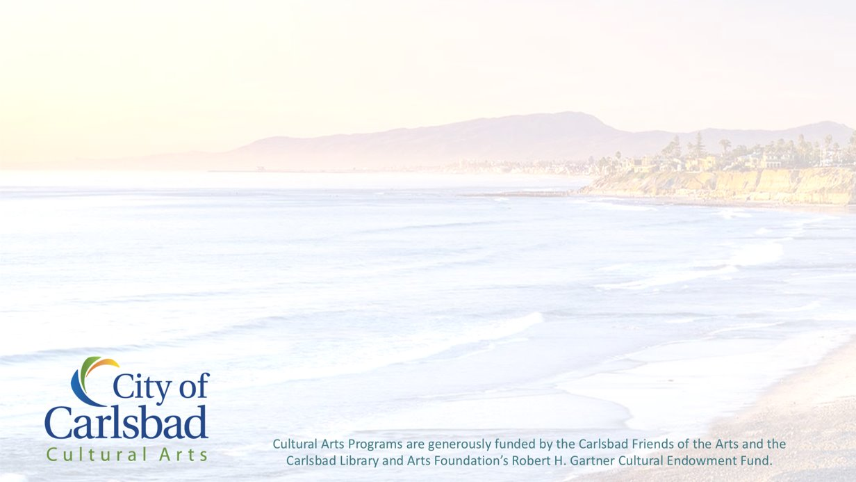
Three Part Art Program
Grades 1-5
William D. Cannon Art Gallery Exhibit:
Reimagined: The Artist’s Book
Feb. 26 – May 14, 2022
Pre-Visit & Post-Visit
Lesson Images

Slide 2
Pre-Visit
Lesson Images

Slide 3
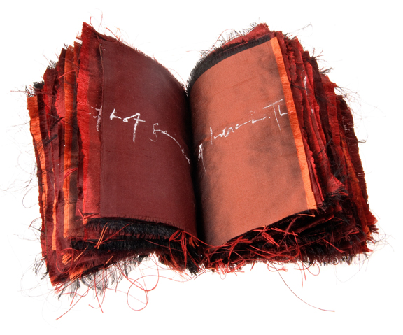
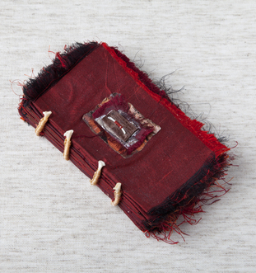
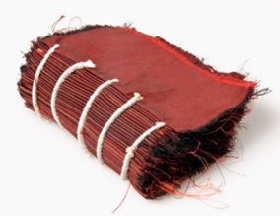
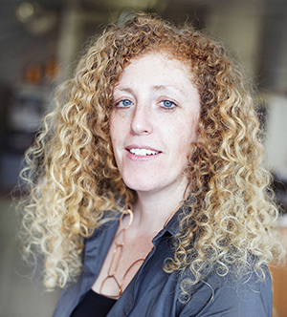
Rhiannon Alpers
Saying Goodbye, 2010
raw silk fabric, hand lettering, fox bones, found collage materials, artificial sinew
(box: silk book cloth and raw silk, paper, ultra-suede)
Photo: rhiannonalpers.com

Slide 4
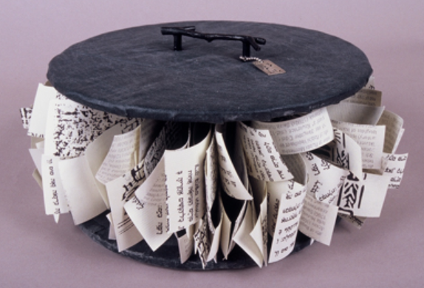
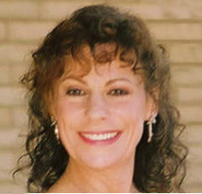
Photo: vivianalombrozo.com
Viviana Lombrozo, Legacies to Carry On, 2010, wood, paper, fabric

Slide 5
Post-Visit
Lesson Images

Slide 6
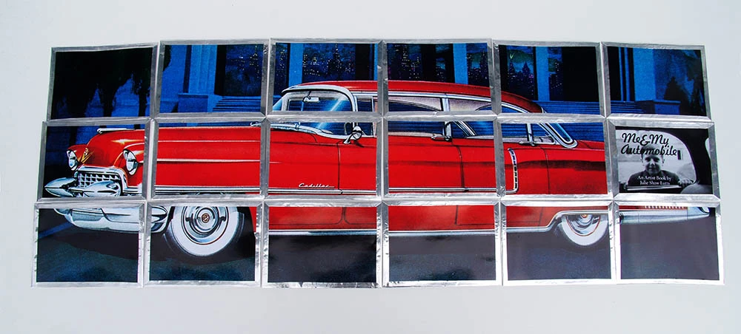
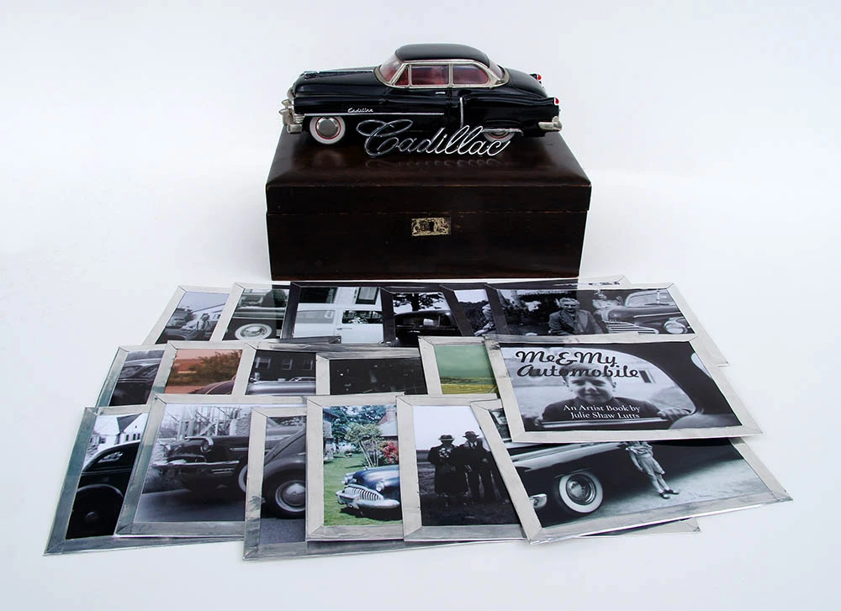
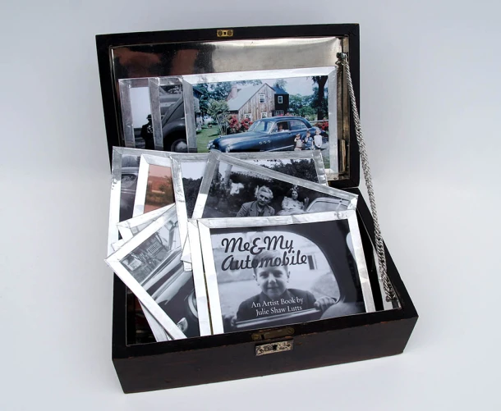
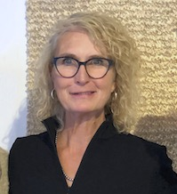
Julie Shaw Lutts
Me & My Automobile, 2019
Mixed paper, metal, vintage wooden box, toy car
Photo: New England Book Artists

Slide 7
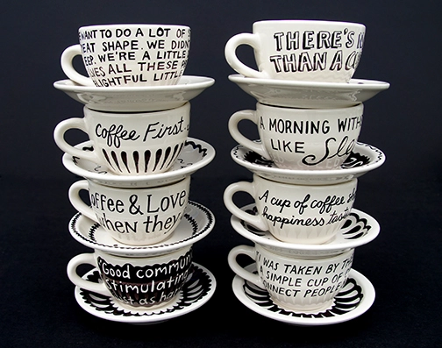
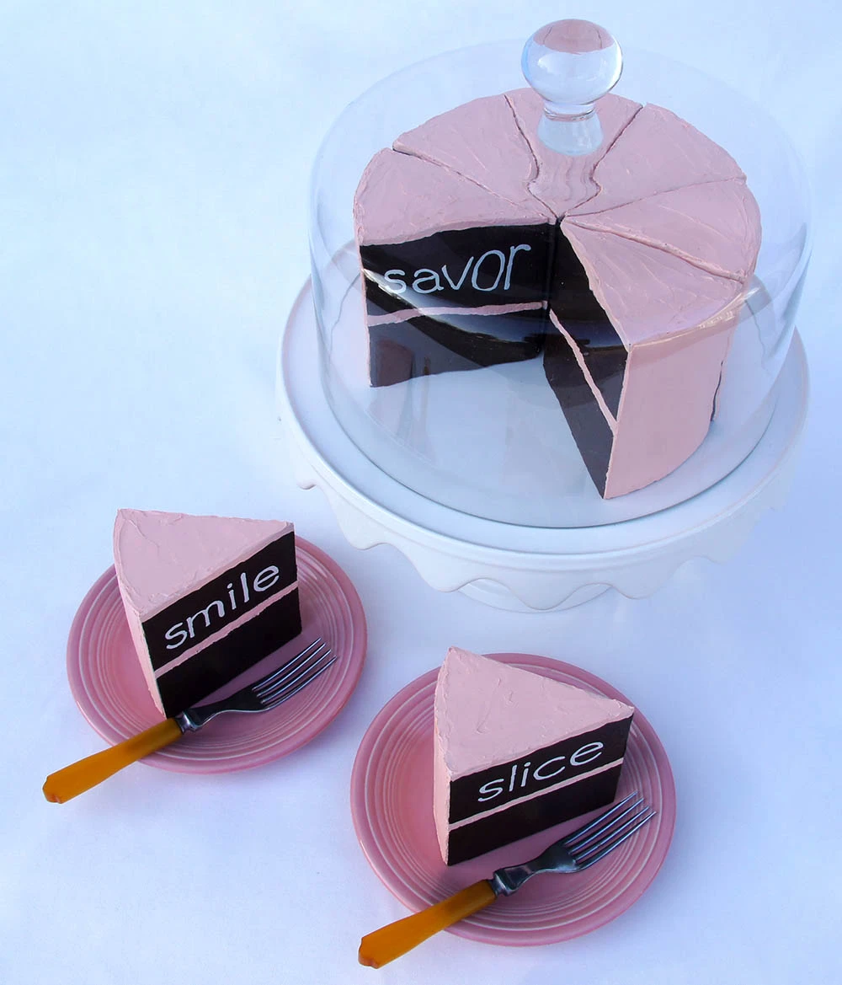
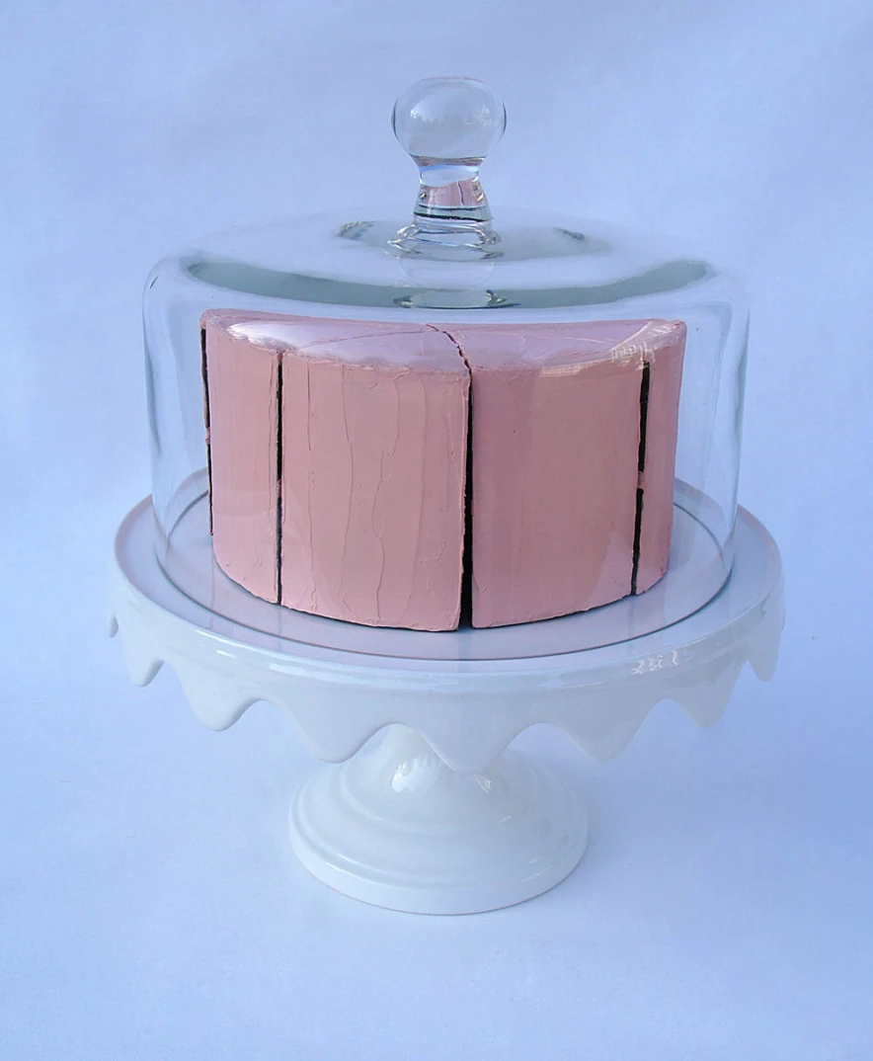
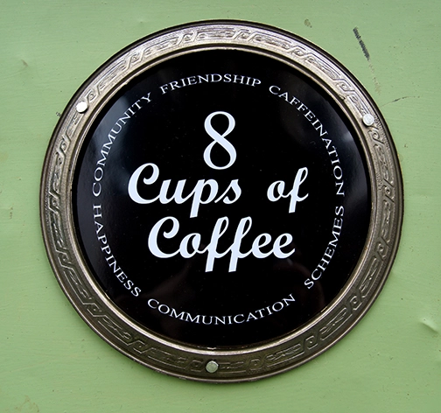
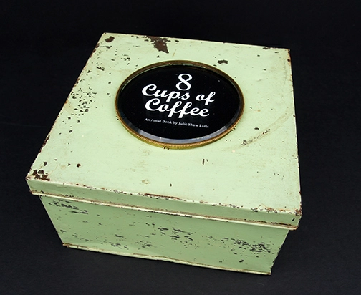
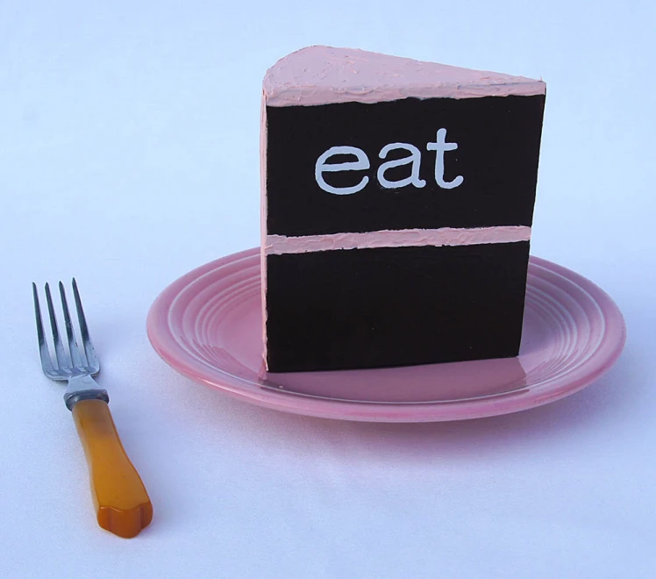
Julie Shaw Lutts
8 Cups of Coffee, 2020
mixed porcelain, ink, vintage metal box
Julie Shaw Lutts
How to Eat Cake, 2016
mixed wood, paint, pottery, glass, bakelite

